Slide 1
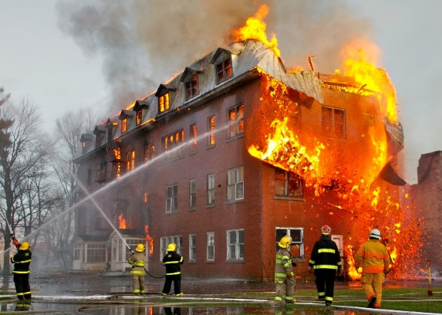
Module 1: What is Fire?
FIRE SCIENCES CORE CURRICULUM

Slide 2
LEARNING OBJECTIVES
Understand wildland fire history
Understand the influence that fire has had on cultural mythology around the world
Know that fire is part of a chemical reaction called combustion
Know the components of the fire triangle
Know the difference between fire intensity and fire severity

Slide 3
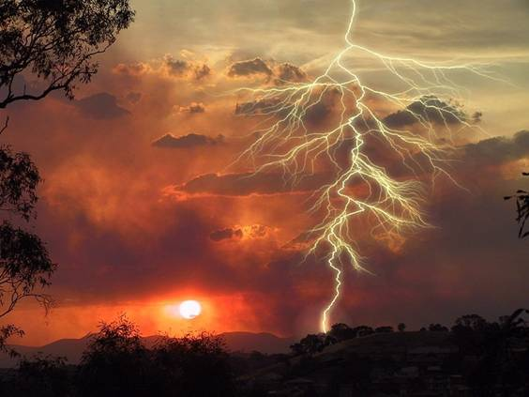
WILDLAND FIRE HISTORY
“The agent by which fire was first brought down to earth and made available to mortal man was lightning. To this source every hearth owes its flames.”
—Lucretius, De Rerum Natura, 50 B.C.

Slide 4
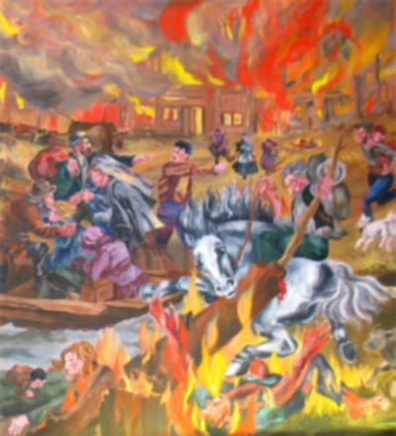
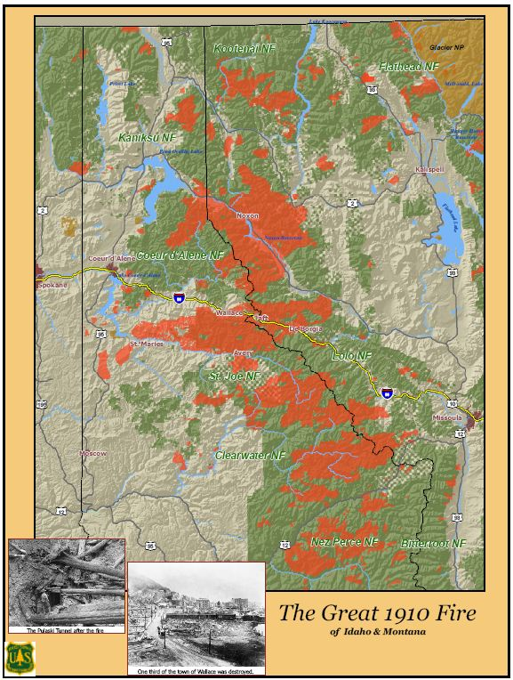
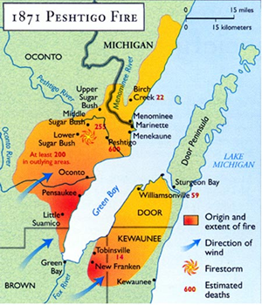
WILDLAND FIRE HISTORY
Notes:
https://www.weather.gov/grb/peshtigofire “The Peshtigo Fire”
http://www.wisconsincentral.net/Culture/Culture/PeshtigoFire.html
http://wildfiretoday.com/2010/03/29/1910-fires/ “The Great 1910 Fires” in Wildfire Today

Slide 5
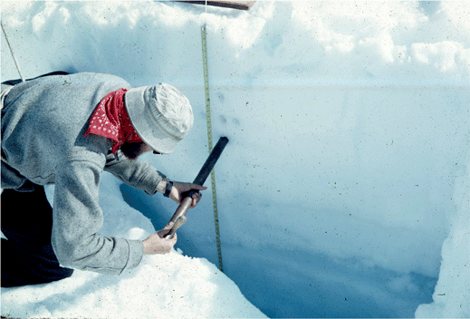
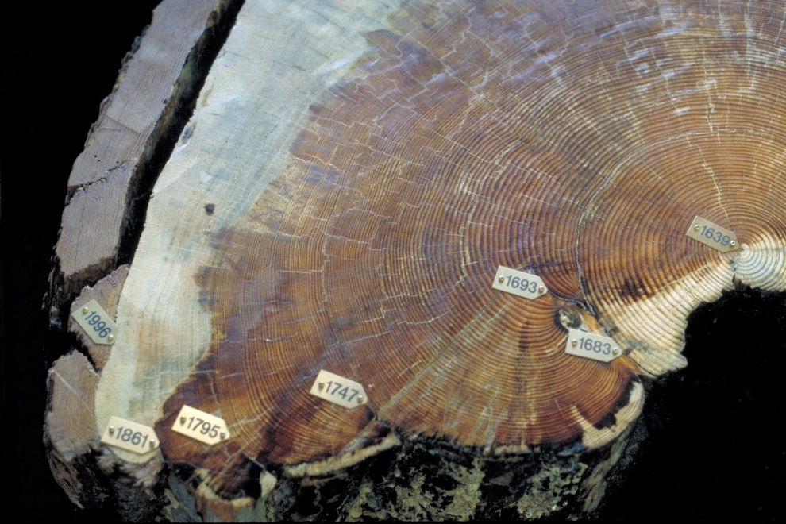
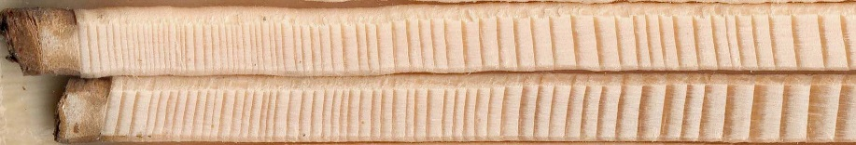
WILDLAND FIRE HISTORY
Ice core analysis
Dendrochronology
Sediment cores
Notes:
-A scientist collecting snow and ice samples from the wall of a snow pit. Fresh snow can be seen at the surface and glacier ice at the bottom of the pit wall. The snow layers are composed of progressively denser firn. Taku Glacier, Juneau Icefield, Tongass National Forest, Alaska. http://pubs.usgs.gov/of/2004/1216/f/images/firn1.gif
-Photo credit: “Fire scares in Pinus ponderosa crosscut” by Chris Schnepf, University of Idaho, available at
https://commons.wikimedia.org/wiki/File:Fire_scars_in_Pinus_ponderosa_crosscut.jpg licensed under CC by 3.0 US
-Photo credit: “Tree rings of Picea Abies (Norwegian Spruce)” by Taxelson, available at https://commons.wikimedia.org/wiki/File:PiceaAbiesWoodsample.jpg, licensed under CC {{PD-self}}

Slide 6
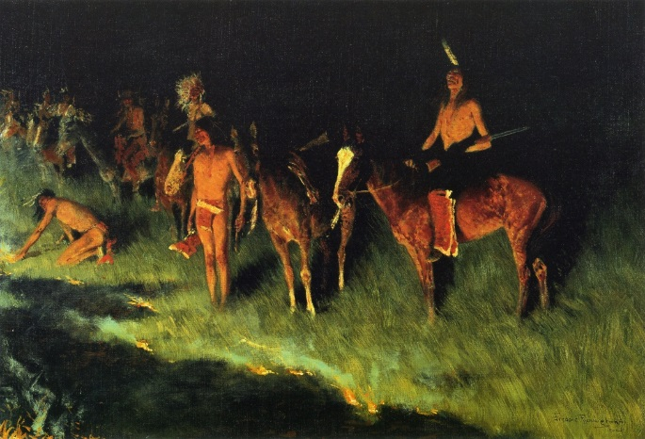
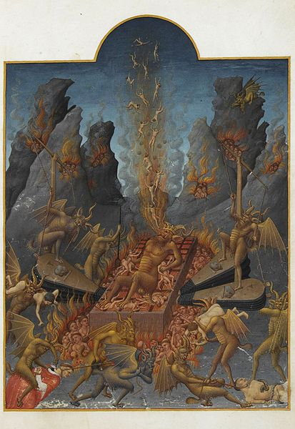
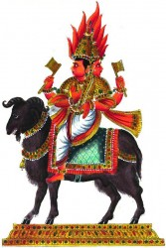
CULTURAL MYTHOLOGY
“Fire does not imply death, but rather change.”
Notes:
-”Fire does not imply death, but rather change” NPS.GOV
-“Agni” by E.A. Rodriquez, at https://commons.wikimedia.org/wiki/File:Agni_deva.JPG, licensed under CC {{PD-1923}}
-The Grass Fire, Frederic Remington 1908, Amon Carter Museum, Fort Worth, Texas. – Public Domain
-Hell by Limbourg brothers, at https://commons.wikimedia.org/wiki/File:Folio_108r_-_Hell.jpg, Limbourg brothers [Public domain], via Wikimedia Commons

Slide 7
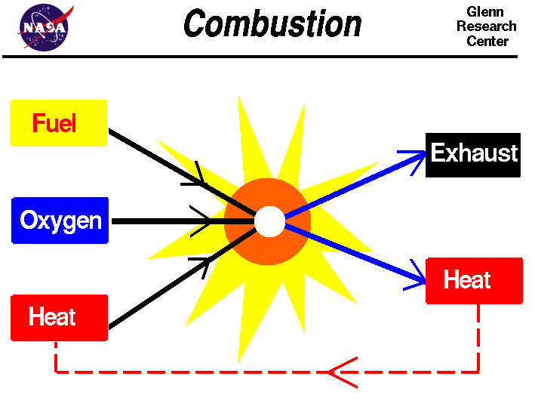
BASIC CHEMISTRY
Combustion
Notes:
https://www.grc.nasa.gov/www/k-12/airplane/combst1.html NASA

Slide 8
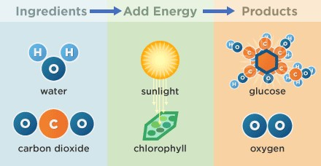
BASIC CHEMISTRY
Photosynthesis
Notes:
“Photosynthesis diagram” by Education Development Center, at http://www.tv411.org/science/tv411-whats-cooking/photosynthesis-science-lesson/activity/1/9, licensed under CC BY-NC-SS 4.0.

Slide 9
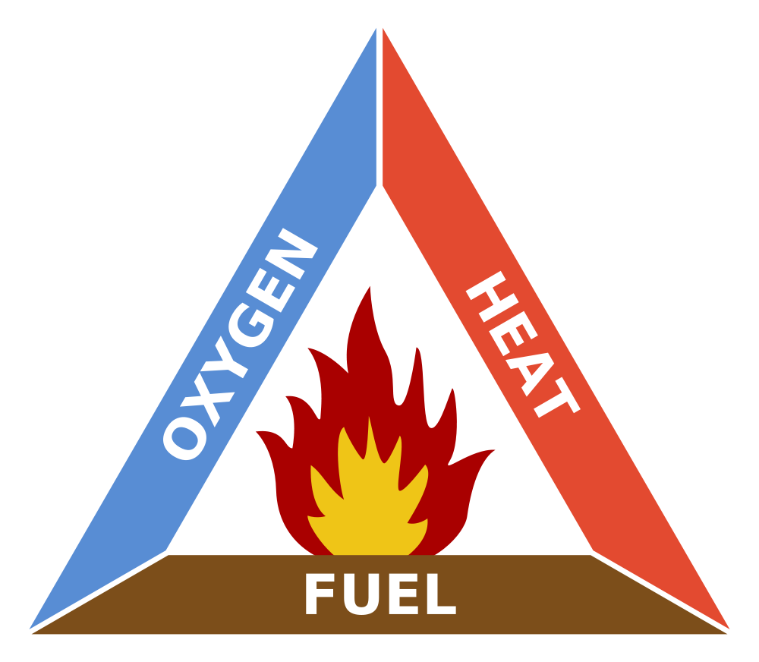
FIRE TRIANGLE
Notes:
Source: “The Fire Triangle” by Gustavb, at https://en.wikipedia.org/wiki/Fire_triangle#/media/File:Fire_triangle.svg, licensed under CC BY-SA 3.0 {{PD-self}}

Slide 10
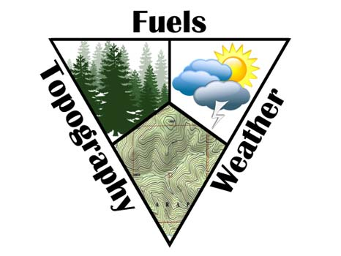
FIRE BEHAVIOR TRIANGLE
Notes:
“Fuel Behavior Triangle” by NWCG, https://training.nwcg.gov/courses/s590/HTML/Fire%20Behavior%20Narratives/groups/13.html

Slide 11
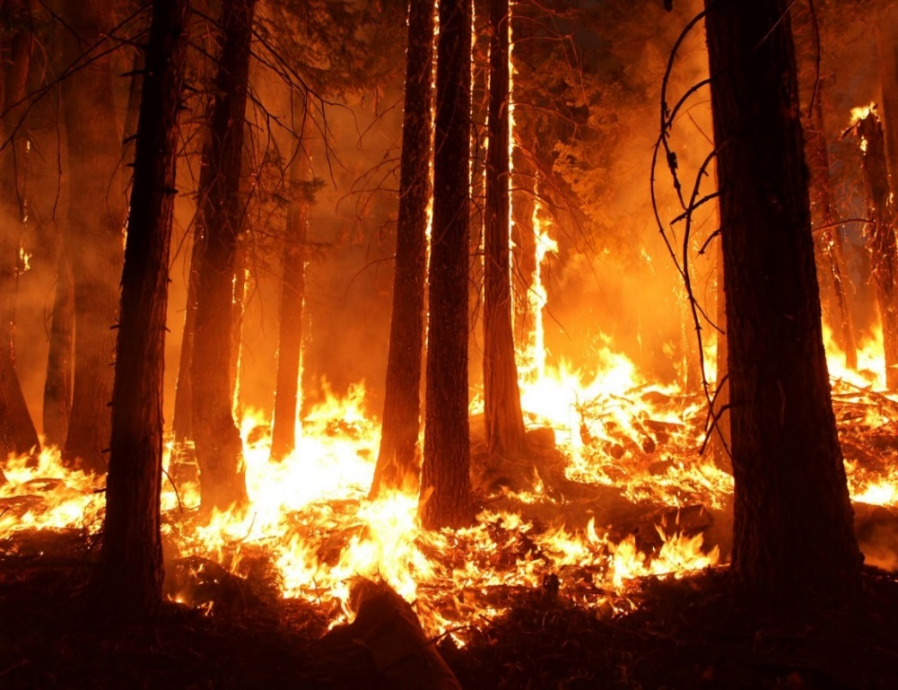

FIRE INTENSITY
Amount of heat (energy) given off by a forest or structure fire at a specific point in time.
Notes:
“2013 Rim Fire in and near Yosemite National Park, CA” http://wildlife.org/wildfire-toward-understanding-its-effects-on-wildlife-from-the-wildlife-professional/ copyright USFS/Mike McMillan
“A photograph of a major fire” by Sylvain Pedneault (Own work), https://upload.wikimedia.org/wikipedia/commons/9/95/FirePhotography.jpg, [CC BY-SA 3.0 (http://creativecommons.org/licenses/by-sa/3.0)], via Wikimedia Commons

Slide 12
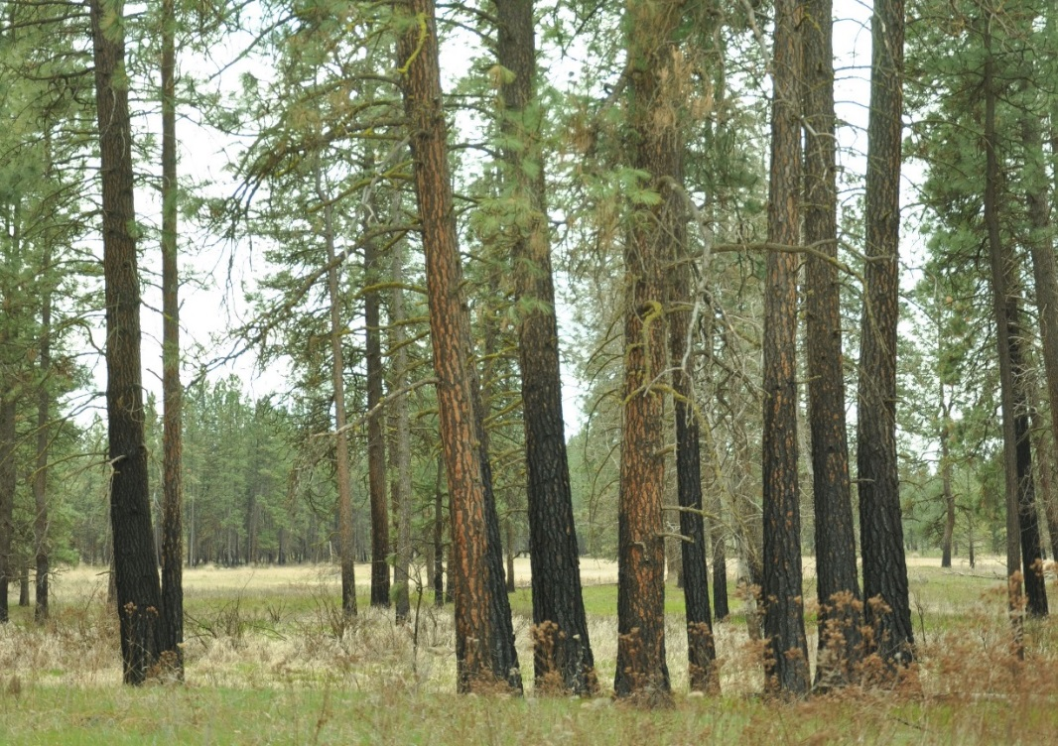
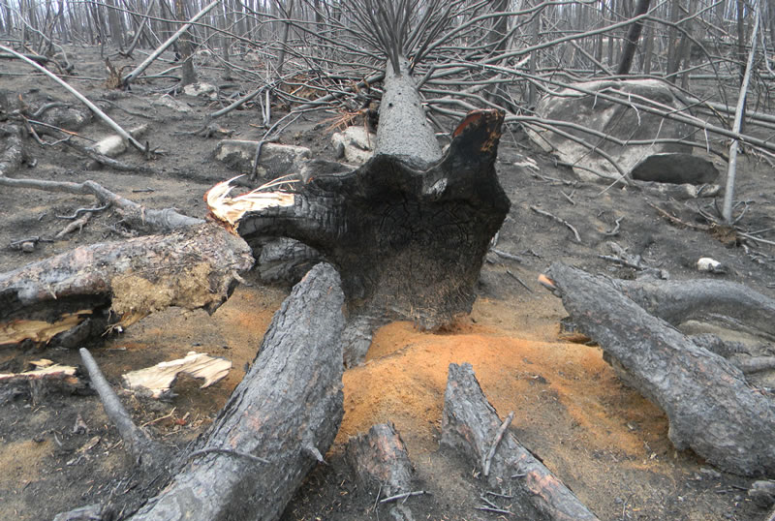
FIRE SEVERITY
LOW Severity
HIGH Severity
A product of fire intensity and residence time
Notes:
“Low severity” by Carrie Berger
“High fire severity in both the overstory and understory” Credit: USFS, Northern Research Station - https://www.nrs.fs.fed.us/disturbance/fire/extreme_fire_effects_mn/

Slide 13

This concludes Module 1 training.

