Slide 1
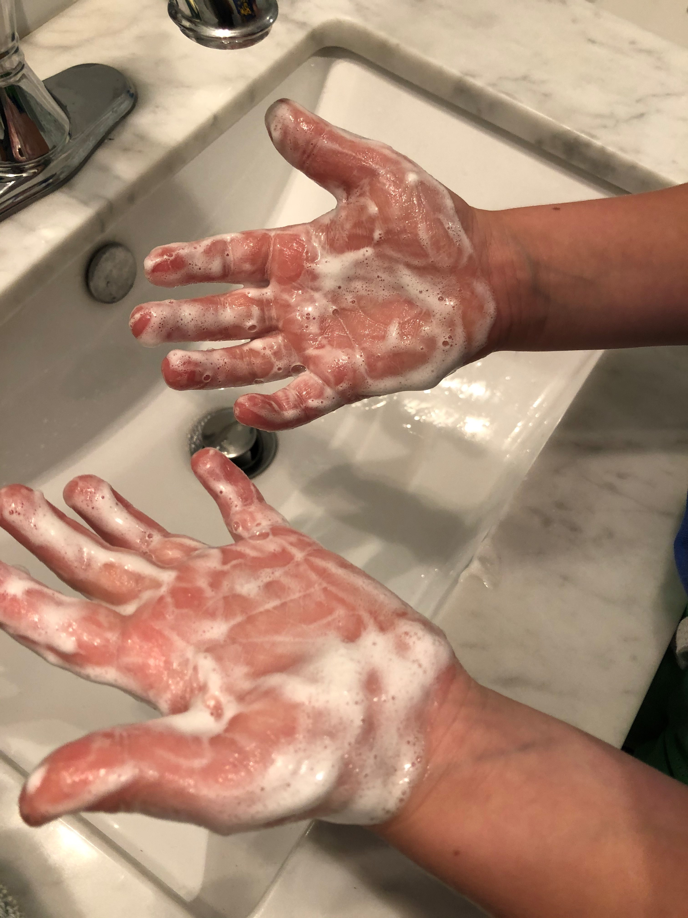
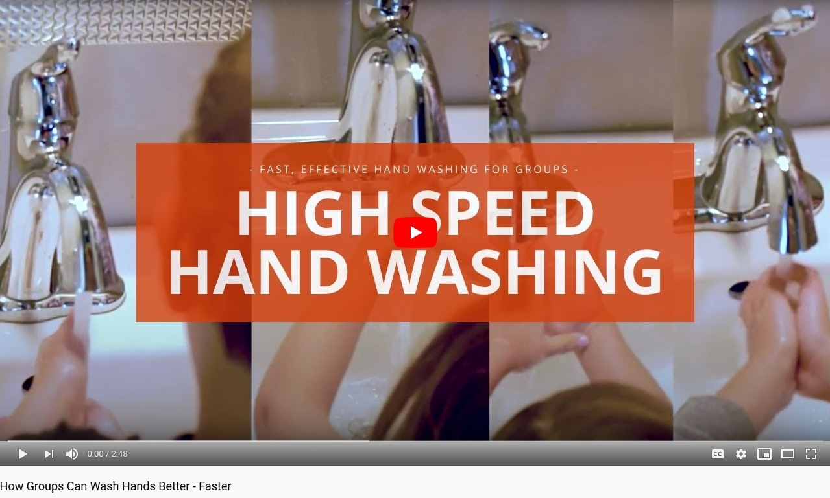
OSU Extension Service
College or department
High Speed Hand Washing in Early Childhood
Lesson Tips in Covid-19
S. Tominey, G. Hyde, L. Kraemer, OSU Extension Service
Learning to wash our hands effectively takes practice for children and adults alike. High Speed Hand Washing can be a fun and safe way to help a group of children wash their hands well and quickly while also social distancing. Use these strategies along with the High Speed Hand Washing: How Groups can Wash Hands Better, Faster video and High Speed Hand Washing youth mini-poster (English/Spanish/bilingual) in your home or classroom.*
Talk with children about dirt and germs.
Let children know that there are good germs and bad germs. Most germs won’t hurt us and one of the best ways we can protect ourselves and one another from germs is by washing our hands! Washing our hands is one way to be a helper to keep our bodies and our friends and family healthy and safe.
Discuss: When should we wash our hands? Brainstorm together all the times during the day we should wash our hands. Make a list or draw a picture to represent all of the ideas children come up with. Be sure to include: After using the bathroom; After playing outside; Before we eat; and After coughing or sneezing.
Watch High Speed Hand Washing: How Groups can Wash Better, Faster video together and talk about it.
Before watching the video, explain that the children in the video will be using a special lotion. They are pretending the lotion is germs and dirt that we cannot see. We can see the lotion with a special light. They will put on the lotion before washing their hands and then use the light to see if they washed and rinsed all off with this special way of washing our hands.
After watching the video, talk with children about what they saw. How is the way the children in the video washed their hands the same as what we already do at home/school? How is it different? When the children finished washing their hands, could you still see the pretend germs (lotion)? Did it work? Let children know that they are going to try and wash their hands like this now, too.

Slide 2
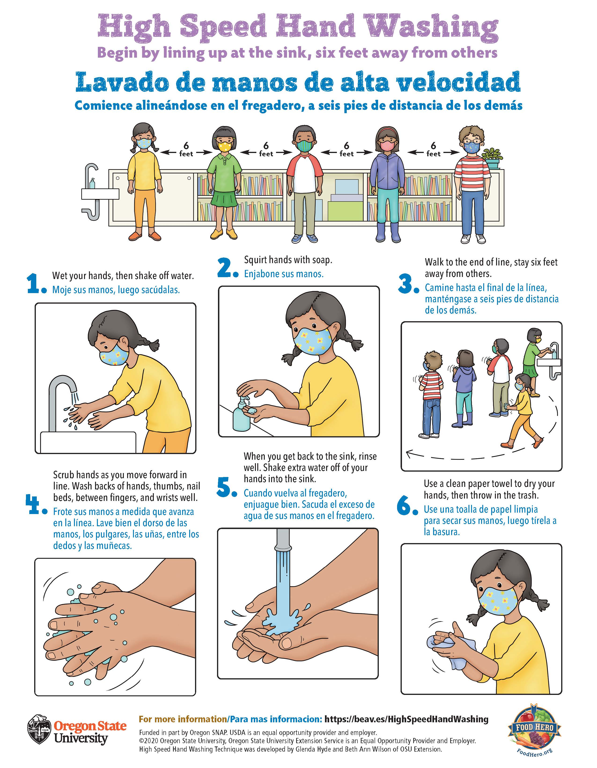
College or department
If you have access to a printer, print black and white copies of the poster on a piece of paper for each child. Have children (or help children) cut out the 6 steps. Practice putting them in order while acting out each step.
Make hand washing a safe and fun part of your regular routine.
Put place markers on the ground where children can stand while waiting for the sink and lathering. Sing a short song while lathering up together or have children make-believe that they are kneading playdough or making snowballs. Ask children to “See if you can cover your entire hands - fronts, backs, and cracks - with bubbles before rinsing.”
*Be sure to follow your state’s safety guidelines for wearing masks and social distancing while following high speed hand washing procedures.
Show children the High Speed Hand Washing poster.
Use the High Speed Hand Washing poster to help children remember the steps in order. Talk about each step 1 to 6 while looking at the poster. Ask children to describe what they see in each picture and role-play, acting out each step. Together, choose a place to display the poster near your hand washing sink.
See English, Spanish and bilingual training video, posters – in color or black and white, the basic lesson plan and other resources at beav.es/HighSpeedHandWashing
2020. Source: Hyde, G. Wilson, B. High Speed Hand Washing Basic Lesson Plan. Photo: Sean Smith. Oregon State University Extension Service prohibits discrimination in all its programs, services, activities, and materials on the basis of race, color, national origin, religion, sex, gender identity (including gender expression), sexual orientation, disability, age, marital status, familial/parental status, income derived from a public assistance program, political beliefs, genetic information, veteran’s status, reprisal or retaliation for prior civil rights activity. (Not all prohibited bases apply to all programs.)

