Slide 1
Produce Safety Alliance – Add-on Exercise for Module 6 v1.2– Post-harvest Handling and Sanitation
Concept Area: Equipment Cleaning and Sanitation
Brief Explanation: The intent of the exercise is for PSA trainees to think through various harvest and post-harvest scenarios and consider implications related to produce safety in the context of real production environments. Following the “Examples of When Corrective Actions Should Be Considered” slide (Slide 45, v1.2), we insert the attached slide deck. Each group of PSA trainees (4-6 per group) is given a set of the printed photos to work through. They are asked the following questions.
Can you identify the surfaces that are food contact surfaces (zone 1)?
Can these surfaces be adequately cleaned and sanitized?
How often would these surfaces need to be cleaned/sanitized?
Who would be responsible for cleaning/sanitizing these items?
How would you document their cleaning/sanitation?
Give the participants 15-20 minutes to work in their groups. Walk around the room and answer relevant questions pertaining to the scenarios. Probe them with additional challenging questions to consider other surfaces or situations that are reasonable in the scenario but may not be photographed.
Go through the slide deck and ask participants to share what they discussed in their groups about each scenario. Ask additional questions or clarify as appropriate. Prompt with questions relating to different approaches for practically managing cleaning and sanitation of various surfaces and the pros and cons to each approach.
Explanations and additional questions are provided in the notes section of each of the following PowerPoint slides. There is no formal evaluation component to this exercise.
Exercise and slide deck were created by Jovana Kovacevic and Joy Waite-Cusic at Oregon State University. The development of this exercise was in combination with the creation of a 2-day Modified PSA training that was funded by the NIFA-Food Safety Outreach Program (FSOP) – Award Number 2017-70020-27250.

Slide 2
Insert Next Slides after “Examples of When Corrective Actions Should Be Considered” (slide 45, v1.2) in PSA Module 6 – Post-Harvest Handling and Sanitation

Slide 3
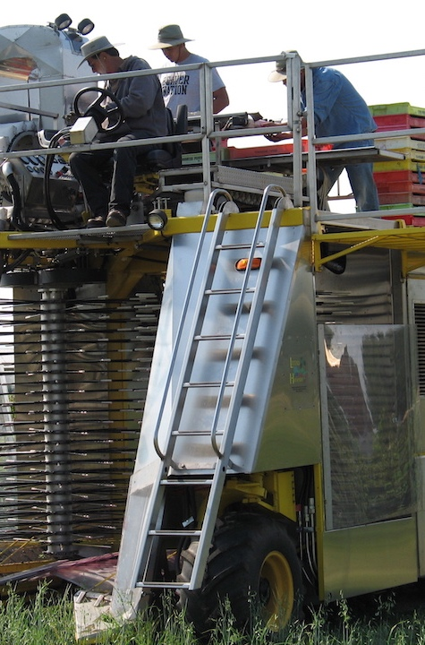
Module 6 Exercise
Cleaning and Sanitation of Harvest and Post-Harvest Tools and Equipment
Notes:
Must be in Slide Master mode to swap out photos.

Slide 4
For each photo, answer the following questions:
Can you identify the surfaces that are food contact surfaces (zone 1)?
Can these surfaces be adequately cleaned and sanitized?
How often would these surfaces need to be cleaned/sanitized?
Who would be responsible for cleaning/sanitizing these items?
How would you document their cleaning/sanitation?

Slide 5
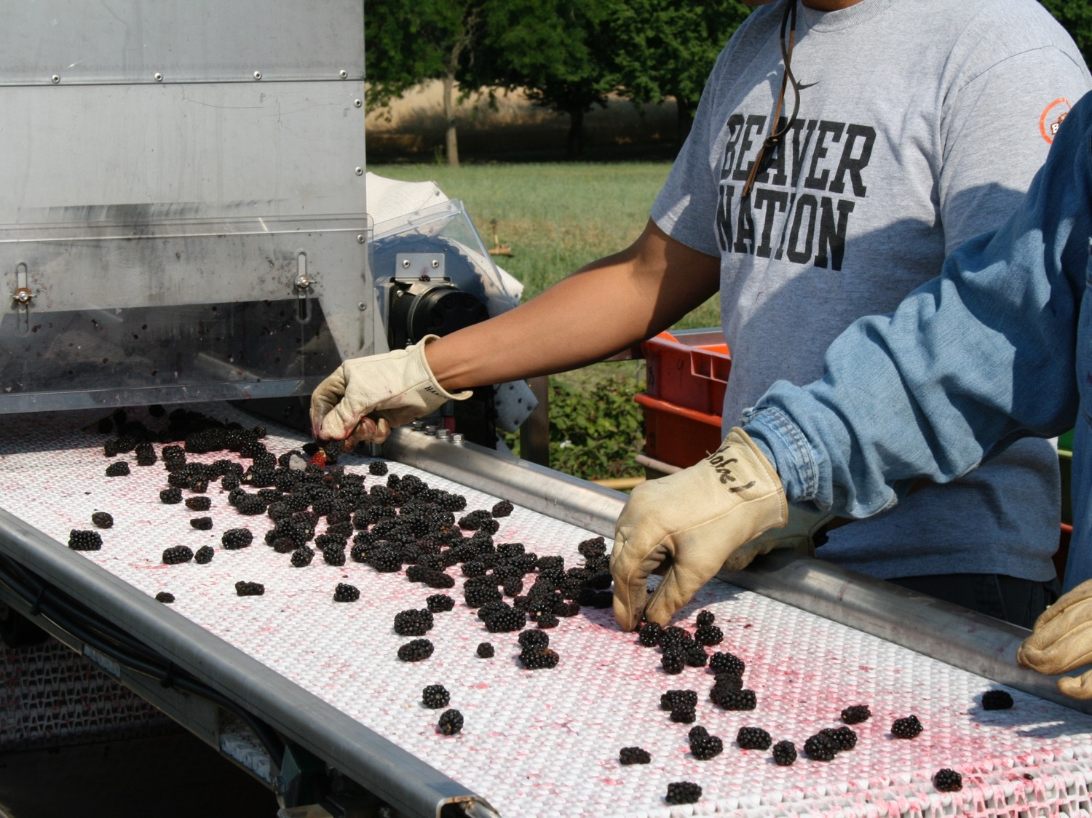
Photo credit: Betsy Hartley, ©date unknown
Notes:
Photo credit – Betsy Hartley, ©date unknown, Oregon State University, Extension & Experiment Station Communications
Blackberry harvest/post-harvest equipment.
Workers are using multi-use gloves for direct contact with fruit. Gloves appear to be made of leather which cannot be easily cleaned nor sanitized.
Equipment surfaces are made of plastic and metal. Plastic surfaces appear to be easily stained and provide a visual history of the product on the belt. Discuss whether staining/coloration of plastic would be an indicator of cleaning/sanitation at some frequency.
Harvest bins are stacked behind the line worker, speculate that these may have been directly on the ground. What challenges are posed with stacked and handling harvest bins?

Slide 6
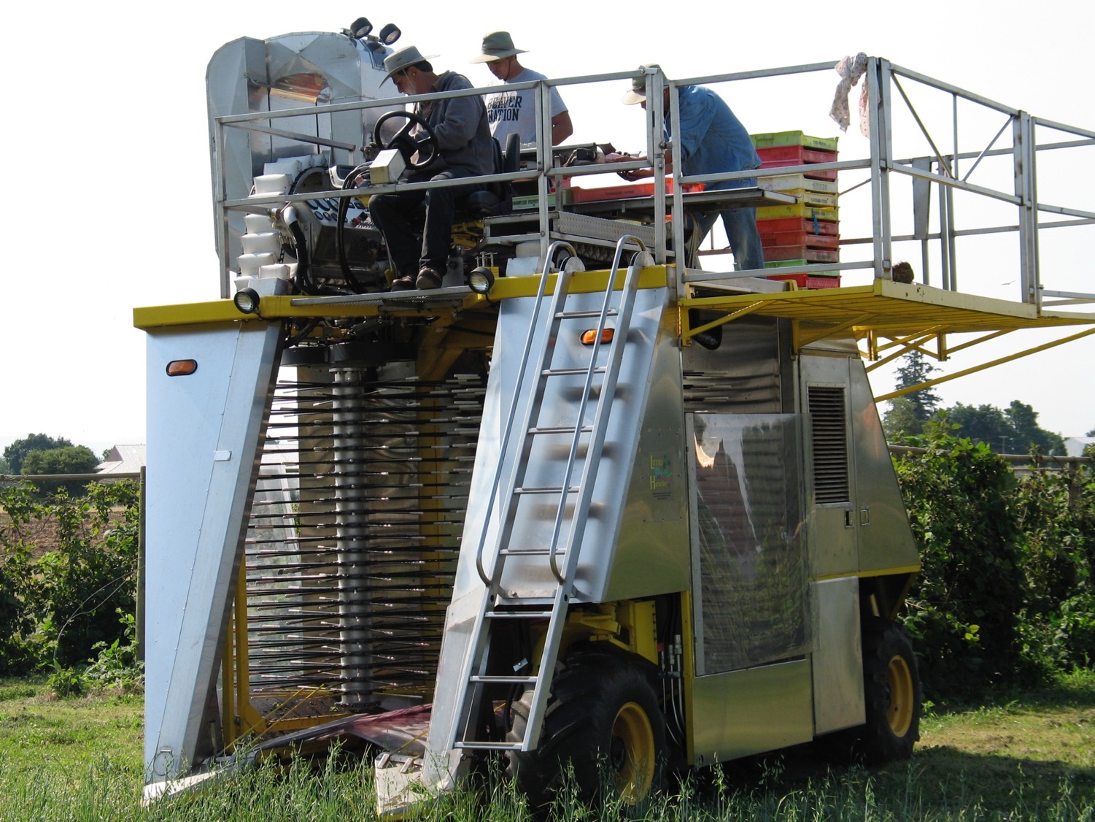
Photo credit: Tiffany Woods, ©2008
Notes:
Photo credit – Tiffany Woods, ©2008, Oregon State University, Extension & Experiment Station Communications
Berry harvester commonly used for blueberries and blackberries in Oregon. These machines have diverse food contact surface types, including woven vinyl or plastic buckets to convey the fruit to the top for sorting and binning. Top of machine is crosshatched metal that is open to the harvested fruit below (potential for contamination from worker footwear to drop onto produce). Cleaning and sanitation breaks with evidence of wildlife in the harvested fruit (birds/mice/feces)? Handwashing or glove changes when sorting fruit that is visibly contaminated?
Cleaning and sanitation procedure for picker? Bins? Handwashing?

Slide 7
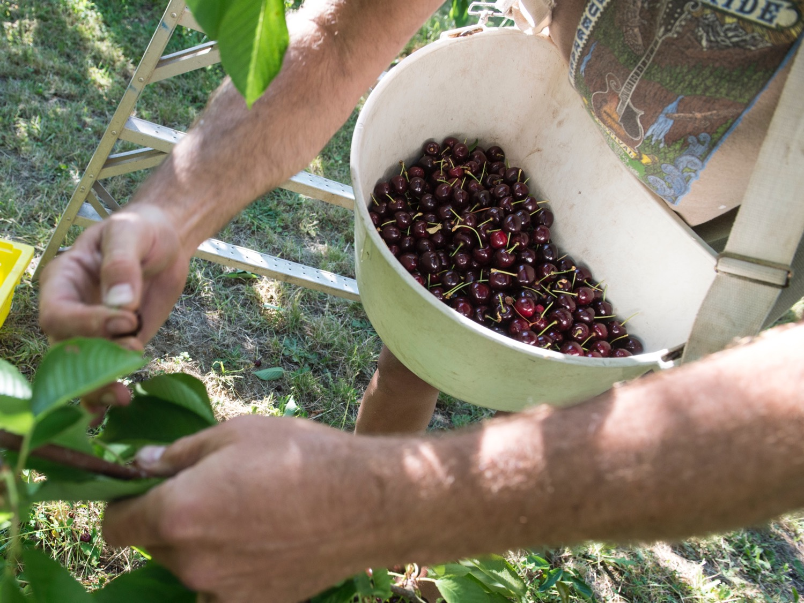
Photo credit: Lynn Ketchum, ©2016
Notes:
Photo credit – Lynn Ketchum, ©2016, Oregon State University, Extension & Experiment Station Communications
Cherry picking harvest container. Cleaning and sanitation frequency? Responsibility? What about staining?
Ladders are commonly used in cherry orchards. The ladders are often touched with hands during climbing and then directly contact the fruit at harvest. Consider cleaning/sanitation of ladders in orchards.
Picking tags/quota tracking sheets are often placed in the harvest containers and dumped into the bins with the picked fruit.

Slide 8
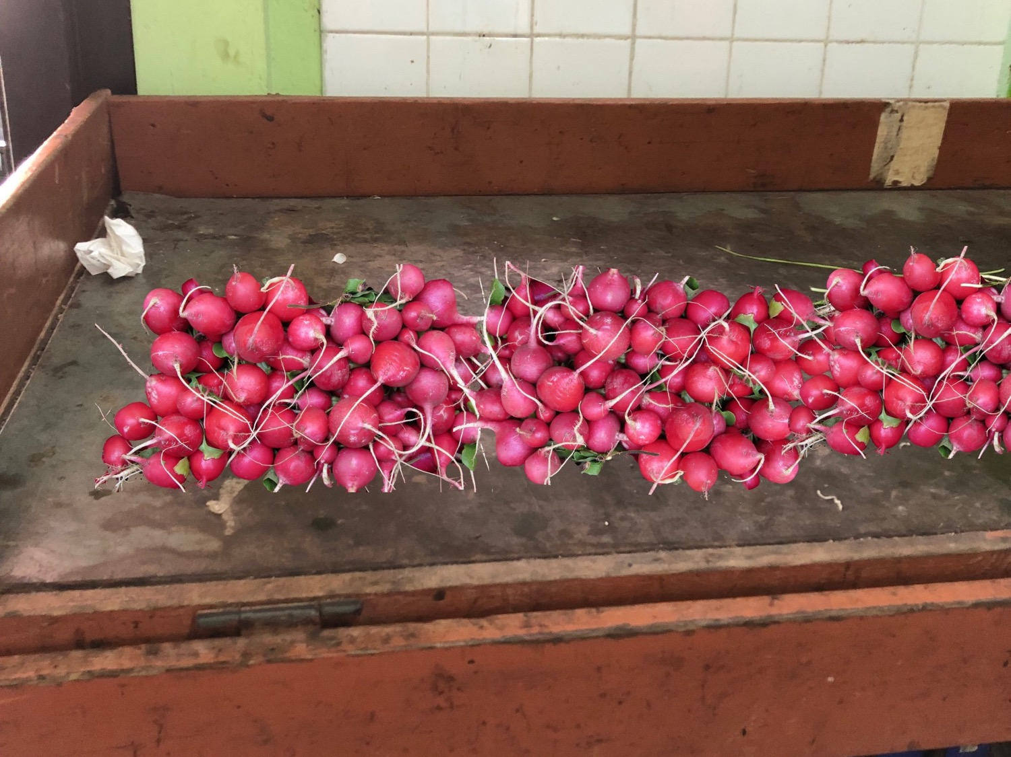
Photo credit: Jovana Kovacevic, ©2018
Notes:
Photo credit – Jovana Kovacevic ©2018, Oregon State University
Wooden table – can it be cleaned and sanitized? Is this a good surface?
Surface of the table accumulates soil, residue, and moisture from the radishes during sorting, and the farmer determines that personnel cannot properly clean the wooden surface of the table manner that protects against contamination. The farm replaces the wooden top of the sorting table with a food grade material top that is of adequate design, construction, and workmanship that farm personnel can adequately clean and maintain. Depending on the circumstances, this could include stainless steel, plastic or other materials. The farm continues to periodically evaluate their practices and procedures.

Slide 9
Photo credit: Lynn Ketchum, ©2010
Notes:
Photo credit – Lynn Ketchum, ©2010, Oregon State University, Extension & Experiment Station Communications
Bins directly on the grass/dirt. What happens when you put them in a vehicle… When would you clean/sanitize these?
A farm uses reusable plastic harvest containers to transport and hold pears. The containers are stored outdoors. The farm’s procedures specify that the containers are to be cleaned prior to use. They specify that the container storage area is to be inspected by a supervisor or other responsible party twice a week. Also, they specify that personnel are to inspect the containers for cleanliness, damage, and poor condition immediately prior to use to protect the fruit that contacts them from contamination. Further, they specify that when personnel observe damage to containers to the extent that they can no longer be properly cleaned, the containers should be discarded. The farm continues to periodically evaluate their practices and procedures.

Slide 10
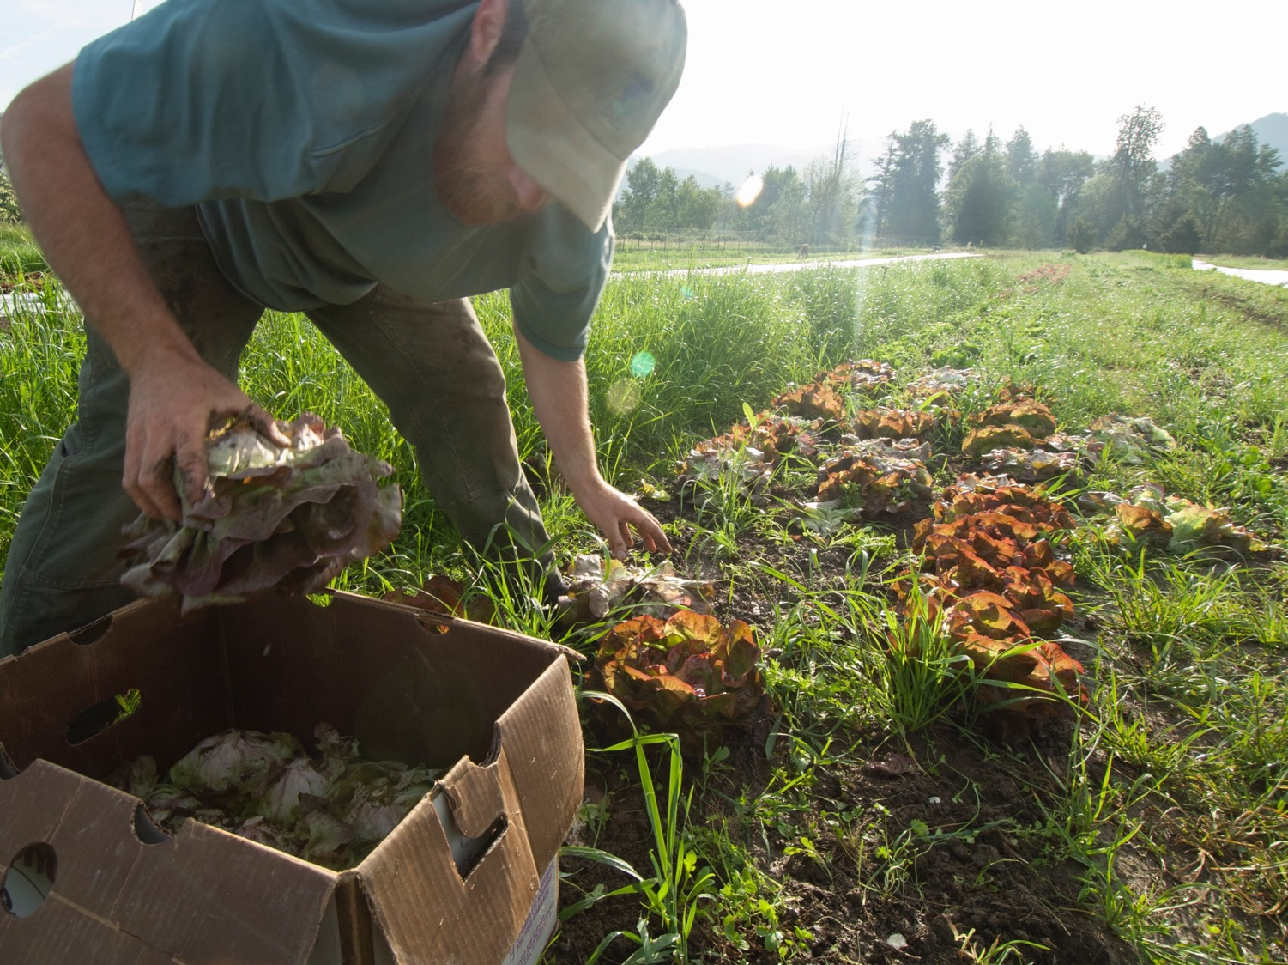
Photo credit: Lynn Ketchum, ©2008
Notes:
Photo credit – Lynn Ketchum, ©2008, Oregon State University, Extension & Experiment Station Communications
Cardboard box – zone 1. If re-using, considering lining? What happens when you stack these on top of each other?

Slide 11
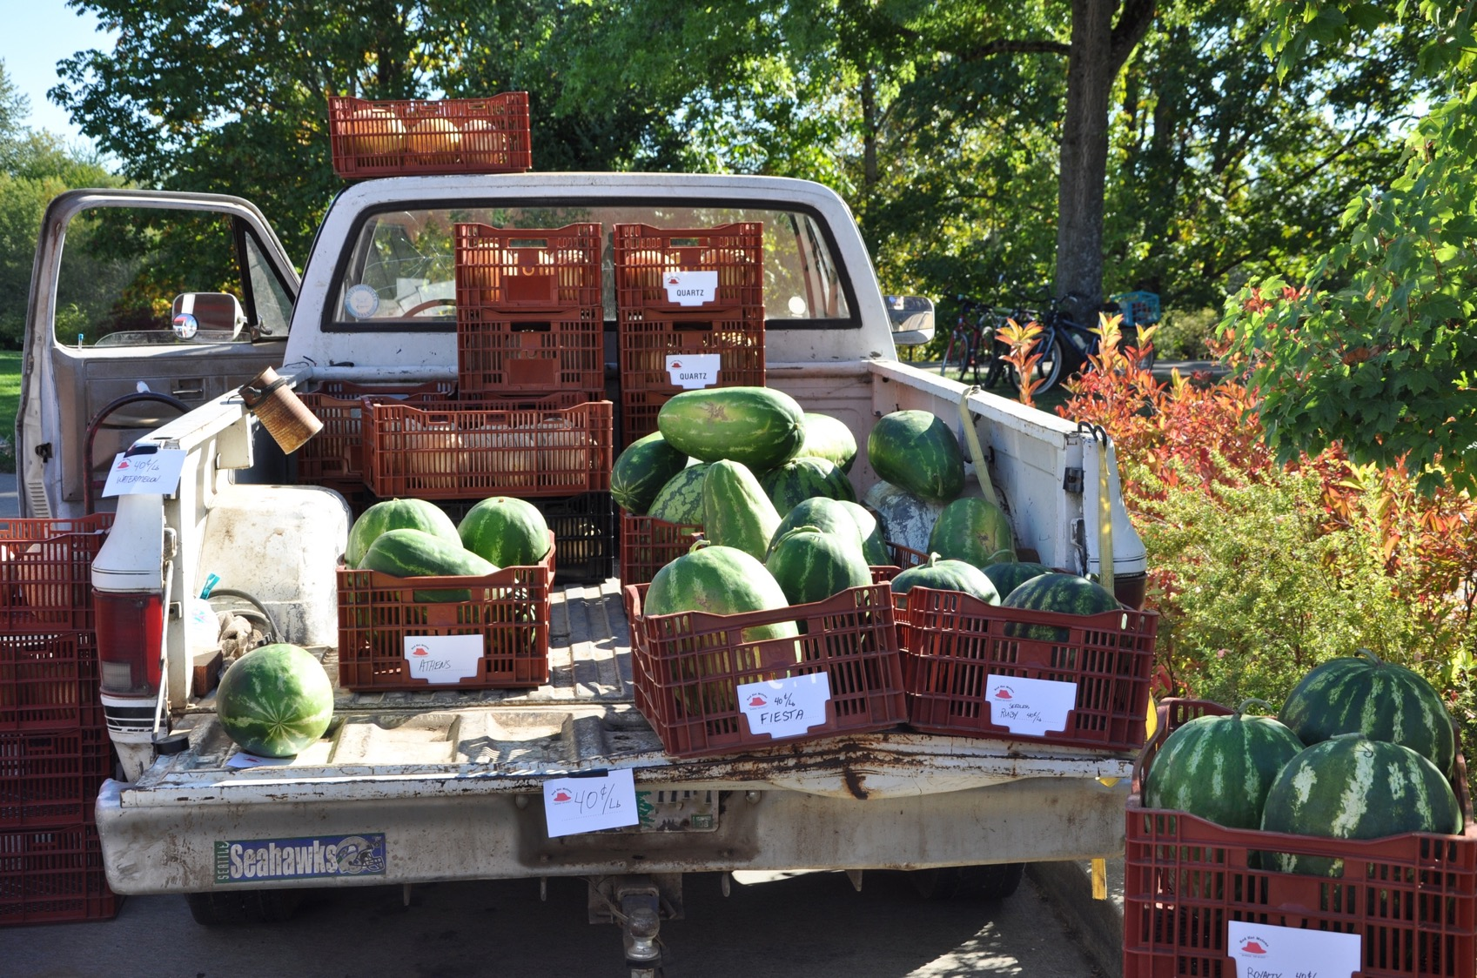
Photo credit: Tiffany Woods, ©2009
Notes:
Photo credit – Tiffany Woods, ©2009, Oregon State University, Extension & Experiment Station Communications
Truck floor – in contact with bins, but bins have holes fruit also placed directly on the surface of the truck bed that is visibly dirty. Is this truck used for other activities? Cleaning and sanitizing before transporting?
Must be adequately clean before use in transporting covered produce, and adequate for use in transporting covered produce. (21 CFR 112.125).

Slide 12
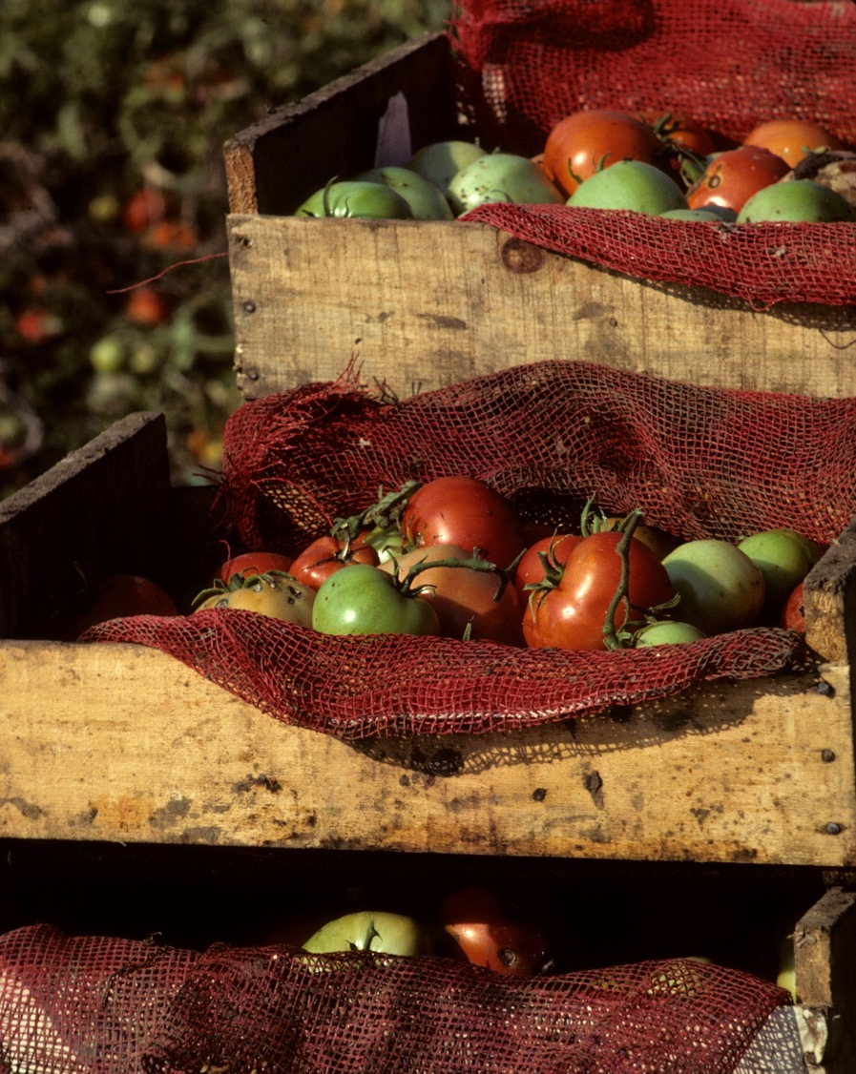
Photo credit: Tom Gentle, ©date unknown
Notes:
Photo credit – Tom Gentle, ©Date Unknown, Oregon State University, Extension & Experiment Station Communications
Harvest containers. Are these single use bags? Would these be appropriate as multi-use bags?
The bags are porous which puts the tomatoes in direct contact with the wooden bins. How are the bins managed?

Slide 13
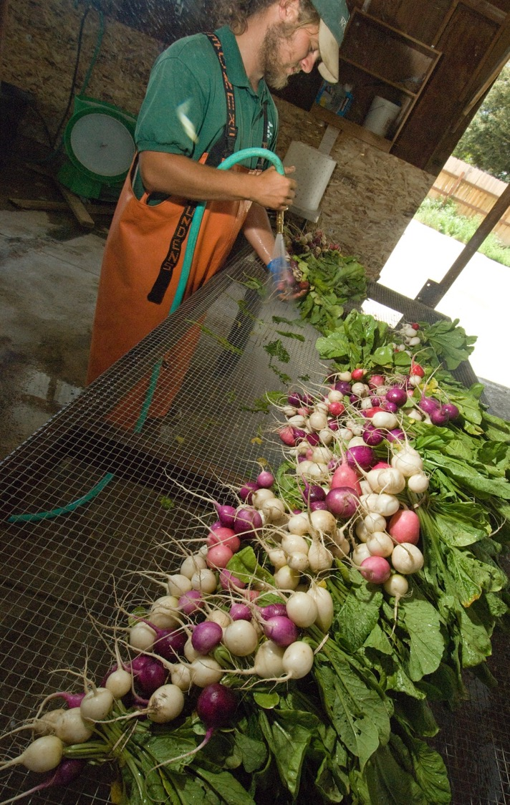
Photo credit: Lynn Ketchum, ©date unknown
Notes:
Photo credit – Lynn Ketchum, ©Date Unknown, Oregon State University, Extension & Experiment Station Communications
Radishes and other root crops are washed in a packing shed to remove soil from the surface. The table is a wire mesh that is stapled to a wooden framed table. Can these materials be cleaned and sanitized?

Slide 14
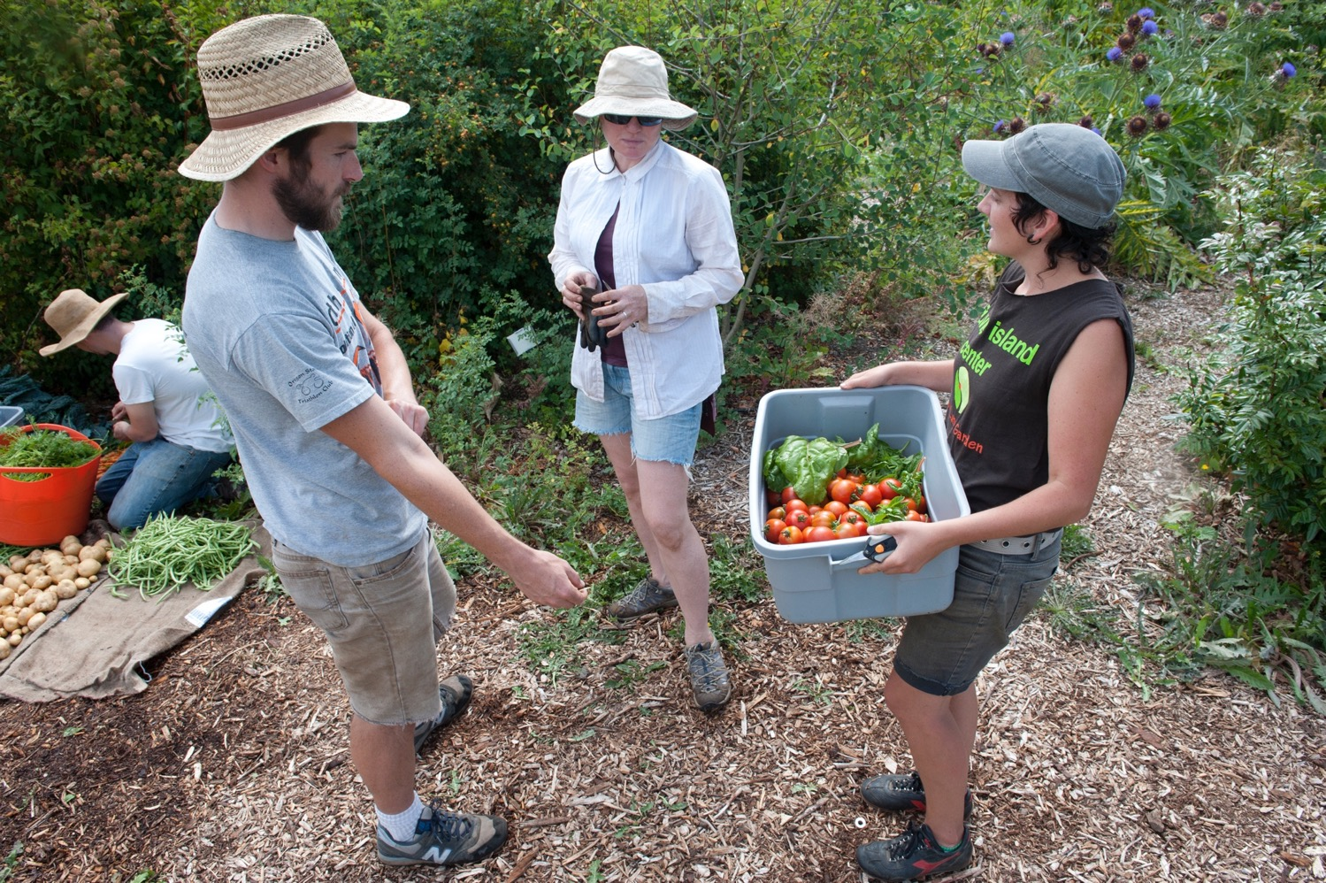
Photo credit: Lynn Ketchum, ©2011
Notes:
Photo credit – Lynn Ketchum, ©2011, Oregon State University, Extension & Experiment Station Communications
Multiple crops are being harvested simultaneously – including crops that are covered by the PSR and those that are not covered by the PSR. How are harvest containers and tools being managed to prevent them from being a source of contamination? What types of surfaces and tools are in this photo? How could these be managed?

Slide 15
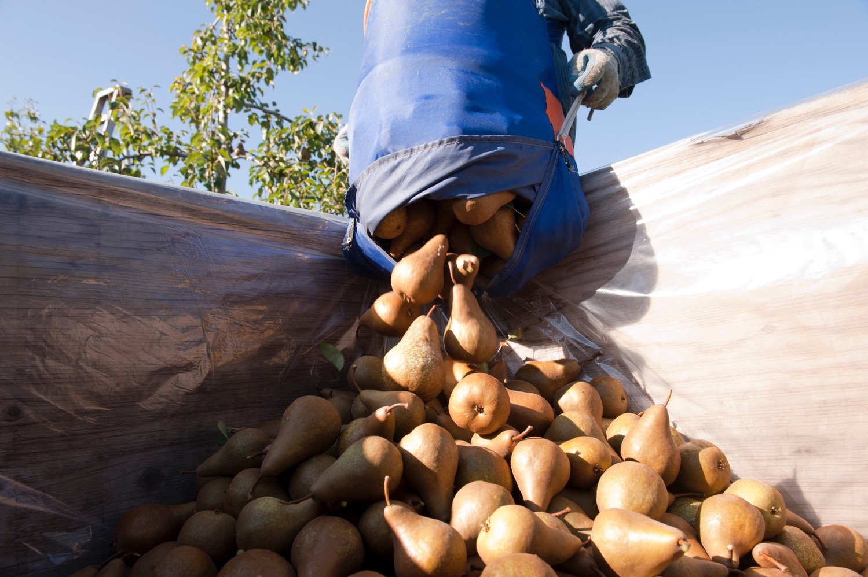
Photo credit: Lynn Ketchum, ©2011
Notes:
Photo credit – Lynn Ketchum, ©2011, Oregon State University, Extension & Experiment Station Communications
Pears being transferred from picker containers to bins. Worker is picking the pears into a flexible fabric pouch. How would the cleaning and sanitation of these be managed?
Worker is wearing multiuse gloves. How would their cleaning and sanitation be managed.
Bin is lined with plastic – presumed to be a single-use liner.

Slide 16
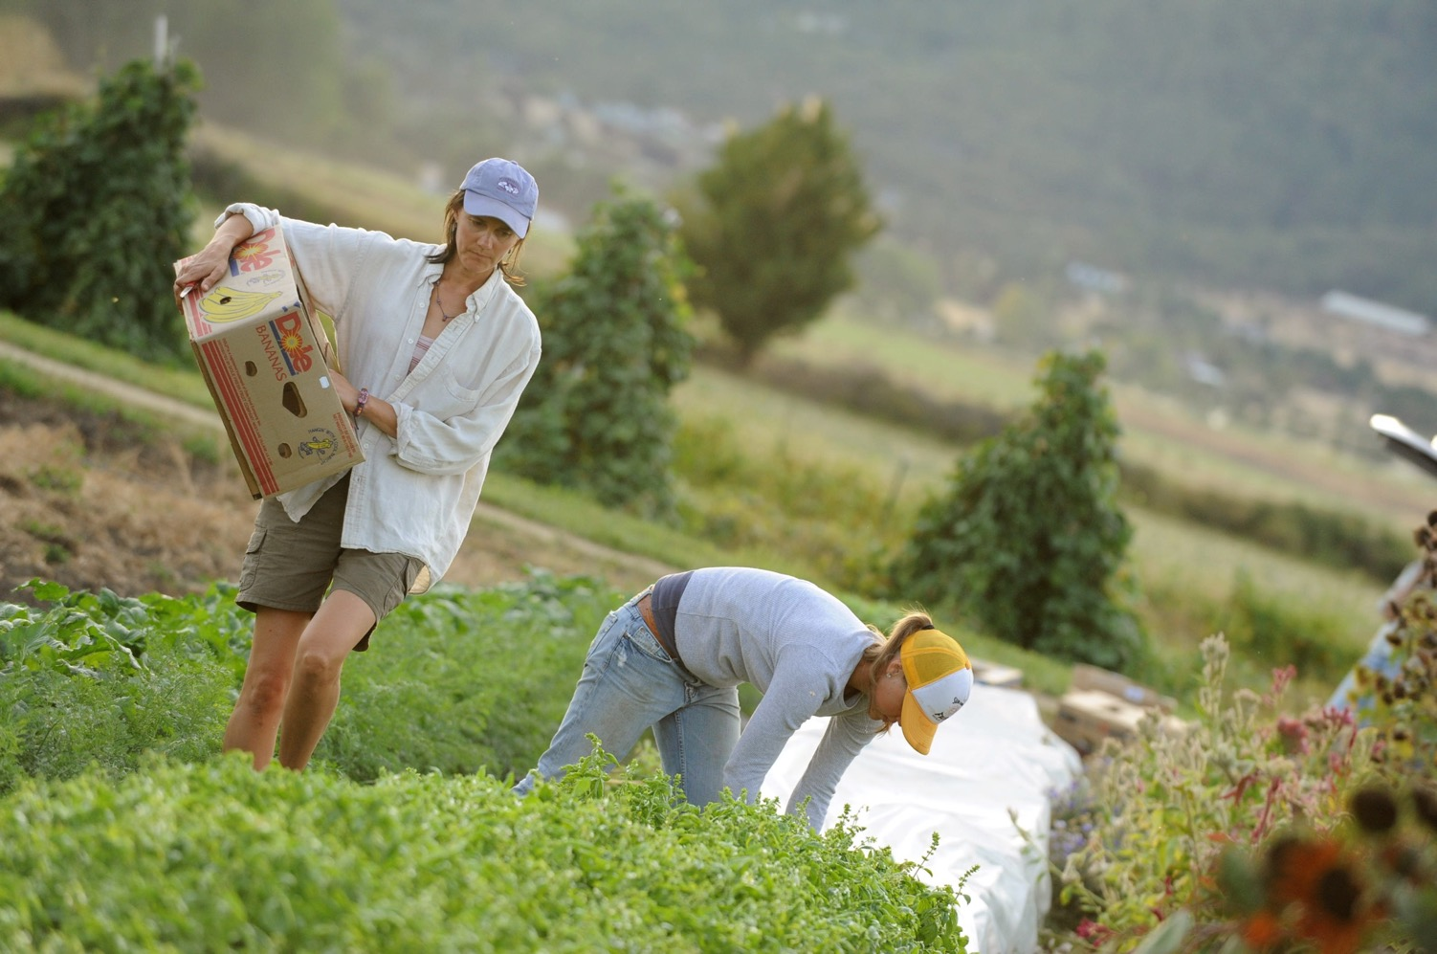
Photo credit: Lynn Ketchum, ©2011
Notes:
Photo credit – Lynn Ketchum, ©2011, Oregon State University, Extension & Experiment Station Communications
Harvest container is cardboard, but it is a reused box that previously stored and transported bananas. Is this a suitable harvest container for covered produce?

