Slide 1
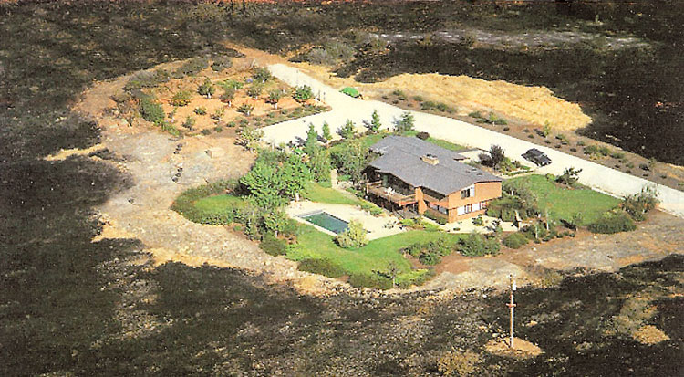
Module 5: Fire Prevention for Home and Landscape
FIRE SCIENCES CORE CURRICULUM

Slide 2
COURSE OUTLINE
Historical context for fires
Risk assessment
Resources available
Designing and creating a fire-resistant home
Defensible space: zones 1, 2, and 3
Defensible space treatments
Ready, set, go!
Public education campaigns
War story

Slide 3
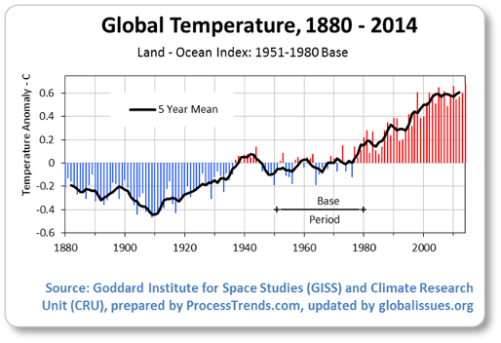
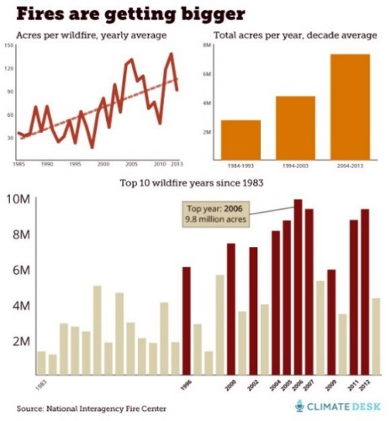
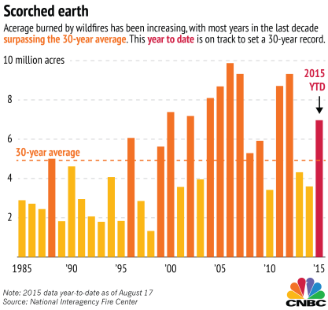
HISTORICAL CONTEXT
“Costs of Wildfires Could Swallow U.S. Forest Service Budget”
“Bigger, Hotter, and Longer Wildfires are the New Normal as the Climate Changes in the West”

Slide 4
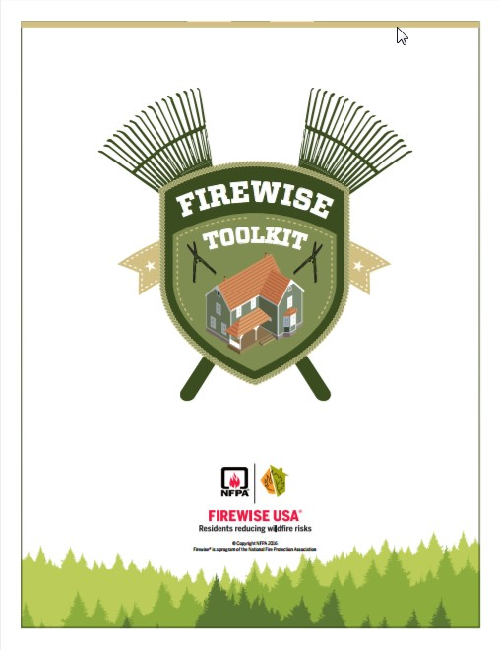
FIREWISE TOOLKIT
http://www.firewise.org/wildfire-preparedness/firewise-toolkit.aspx
Handout: Firewise Toolkit_2016.pdf

Slide 5
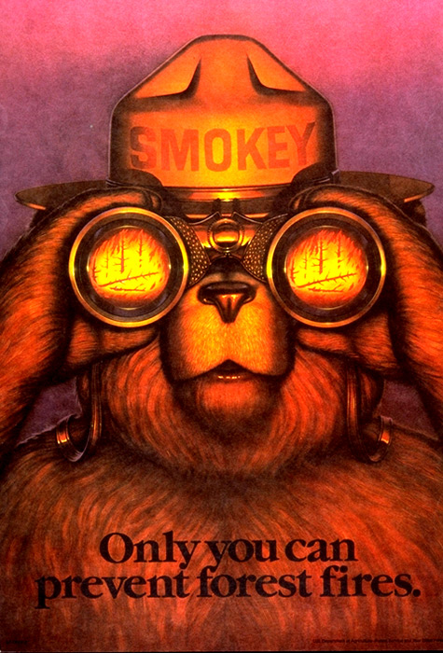
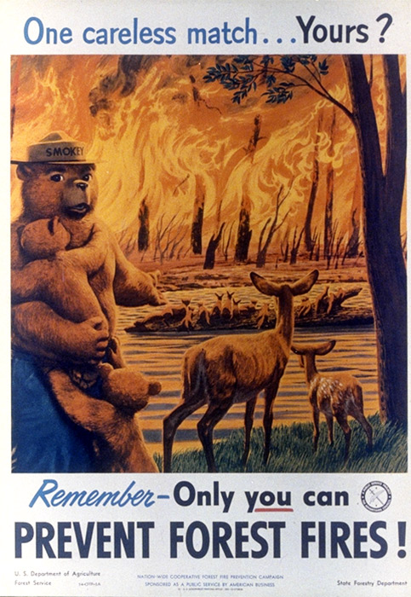
A DAY WITH SMOKEY
A day in the woods with Smokey
Notes:
https://www.youtube.com/watch?v=idS-ryvoGxI

Slide 6
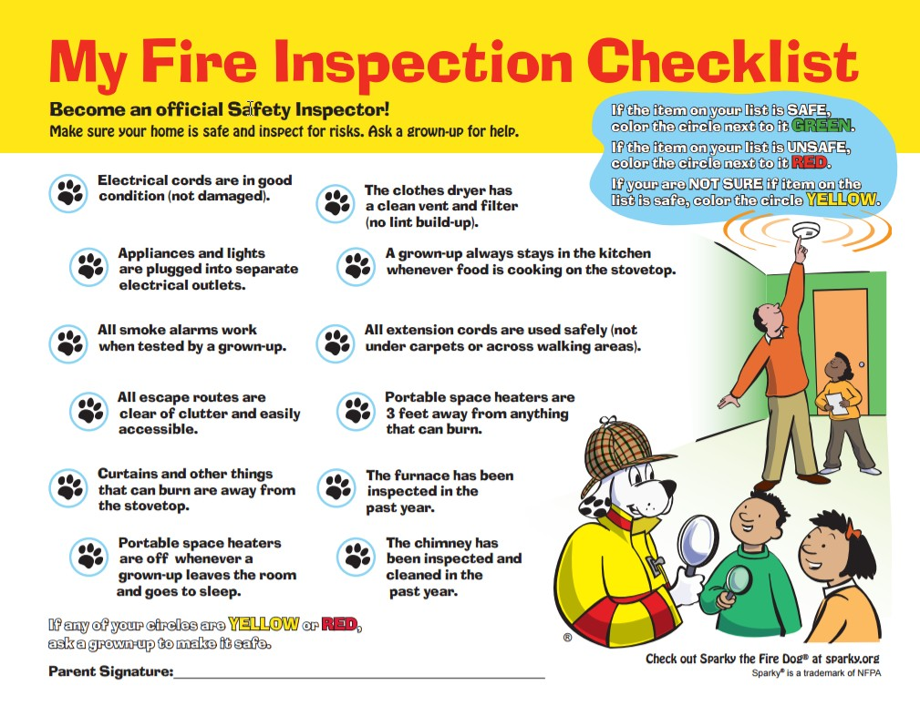
RISK ASSESSMENT
Fire Risk Assessment:
Pre-Plans

Slide 7
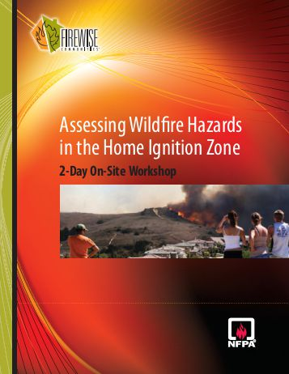
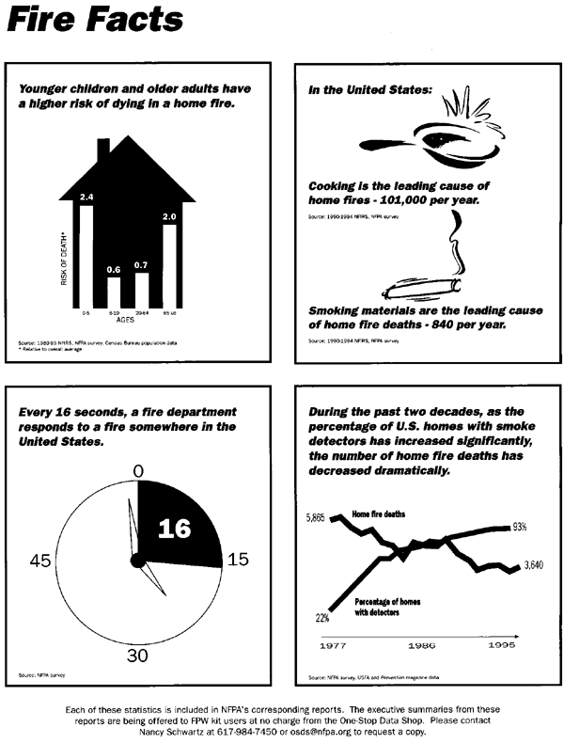
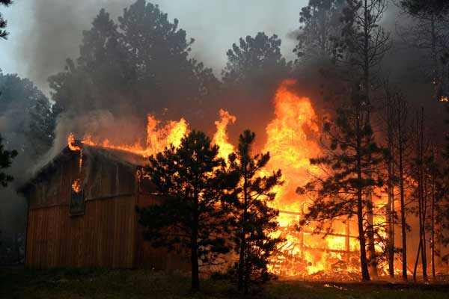
FIRE-RESISTANT HOME
Designing and creating a fire-resistant home

Slide 8
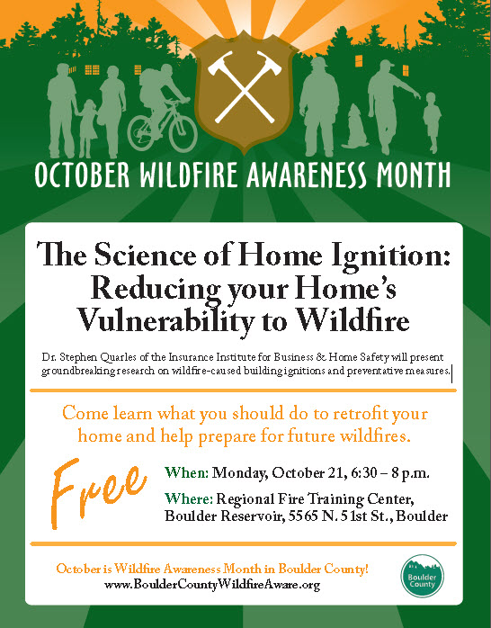
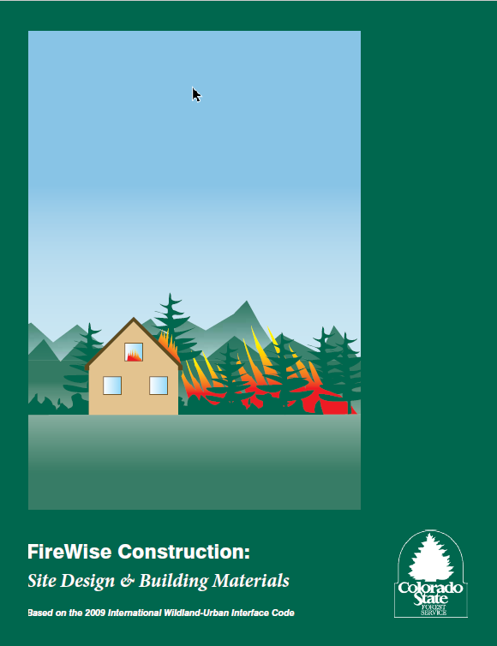
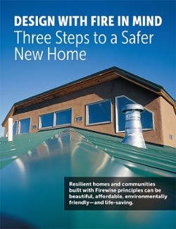
FIRE-RESISTANT HOME
Designing and creating a fire-resistant home

Slide 9
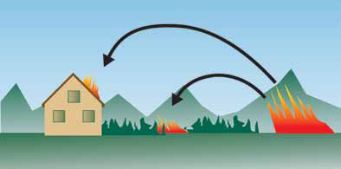
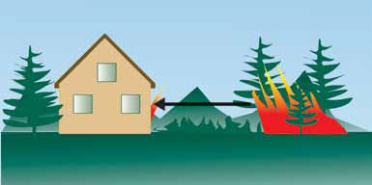
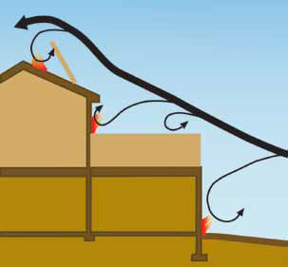
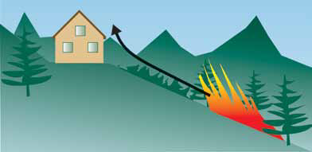
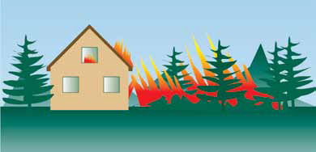
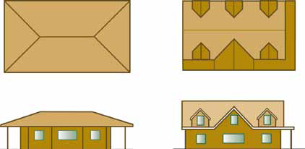
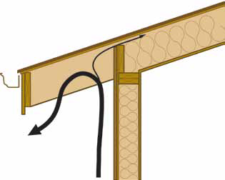
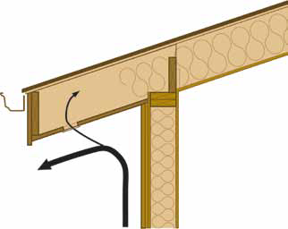
HOME CONSTRUCTION GUIDELINES

Slide 10
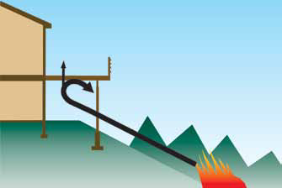
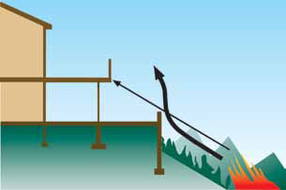
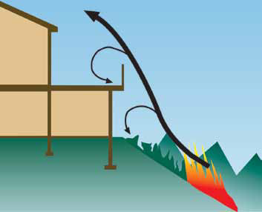


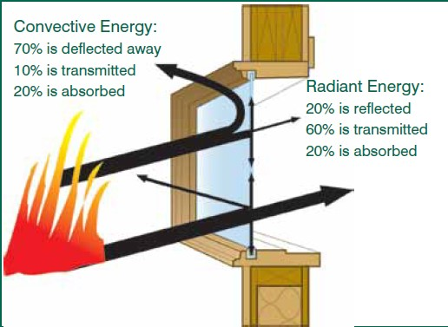
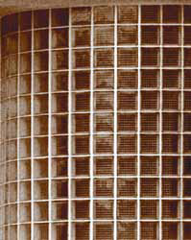
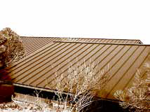

HOME CONSTRUCTION GUIDELINES

Slide 11
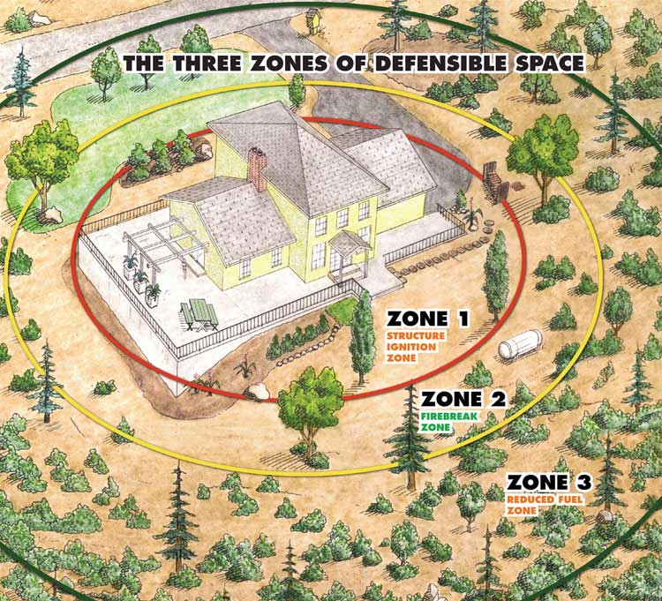
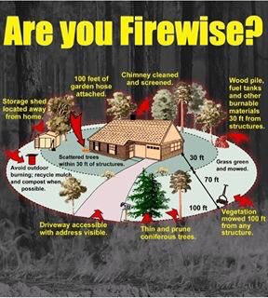
ARE YOU FIREWISE?
Defensible Space zones
1, 2 & 3

Slide 12
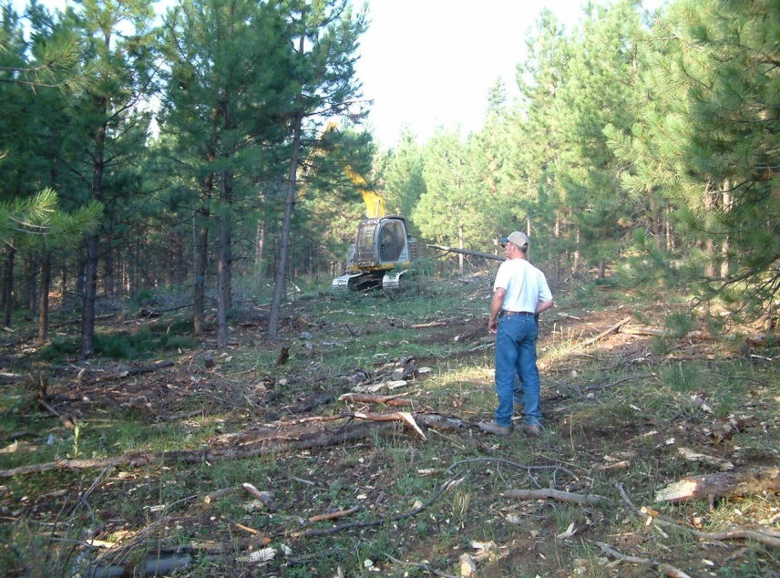
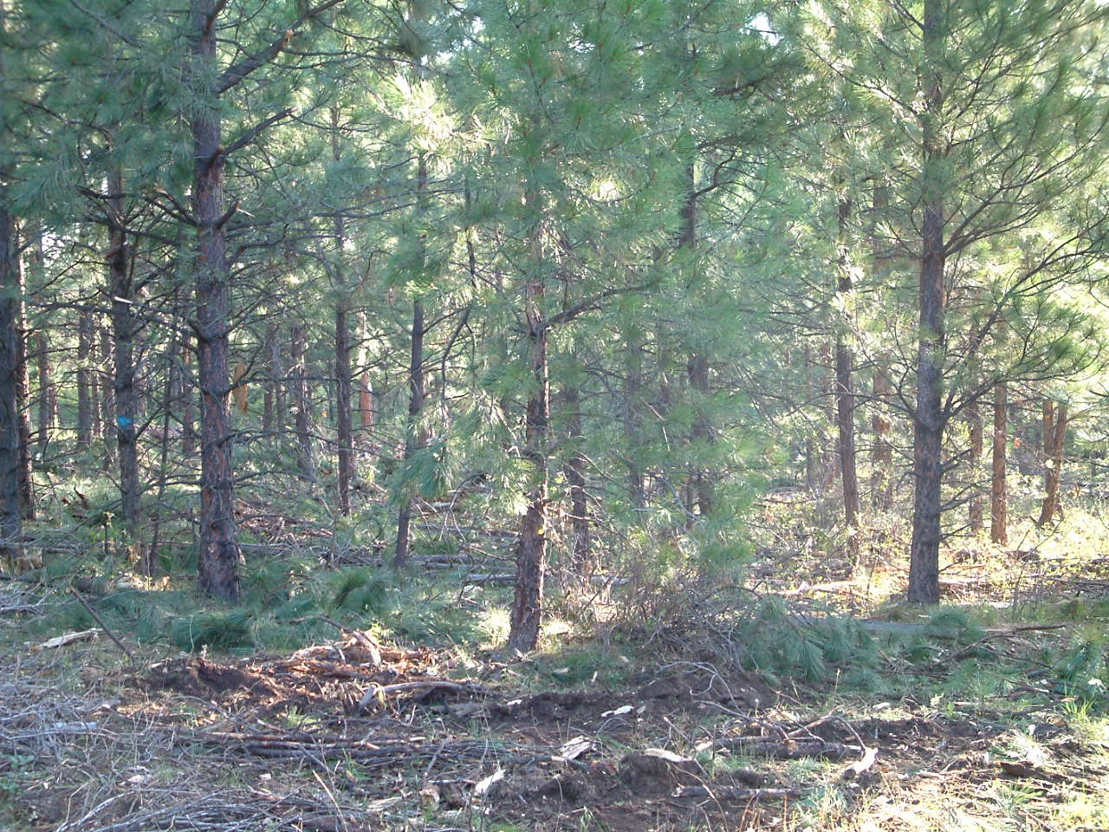
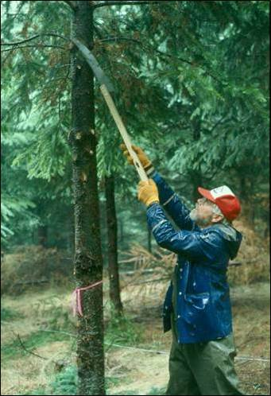
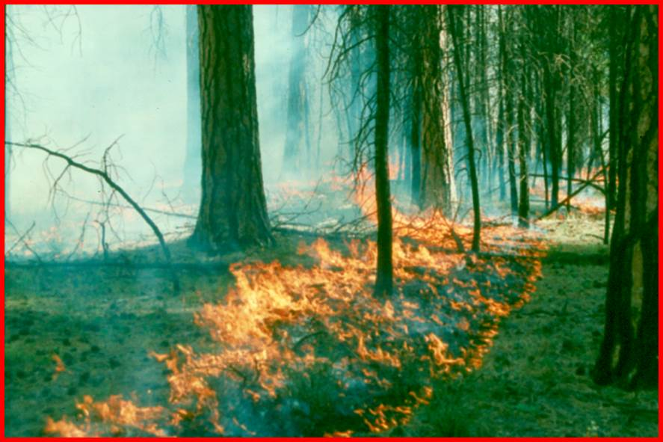
DEFENSIBLE SPACE
Defensible space treatments
Slash Disposal
Prescribed Fire
Thinning
Pruning

Slide 13
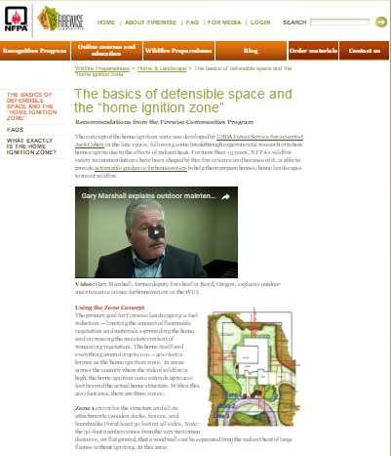
ACTION STEPS
http://www.firewise.org/wildfire-preparedness/be-firewise/home-and-landscape/defensible-space.aspx
Action Steps Around Your Home

Slide 14
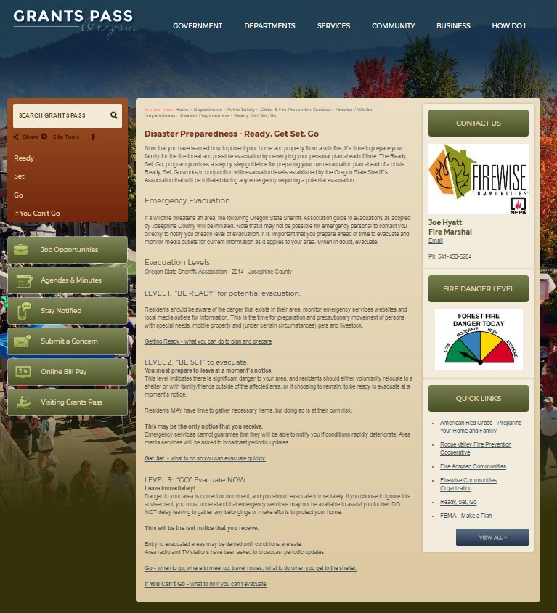
READY, SET, GO!
https://www.grantspassoregon.gov/924/Disaster-Preparedness---Ready-Get-Set-Go

Slide 15

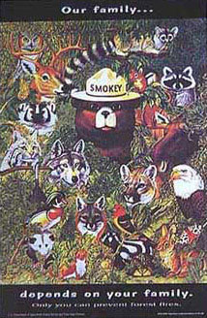
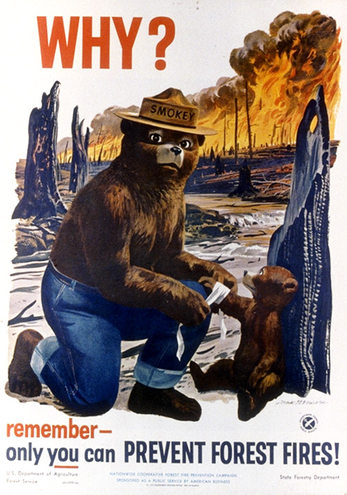
PUBLIC AWARENESS CAMPAIGNS

Slide 16
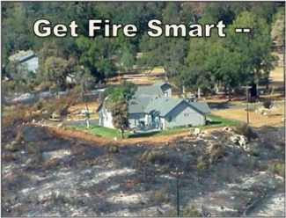
FIRE SCIENCE CORE CURRICULUM
THANKS! AND BE FIRE SAFE

