Slide 1
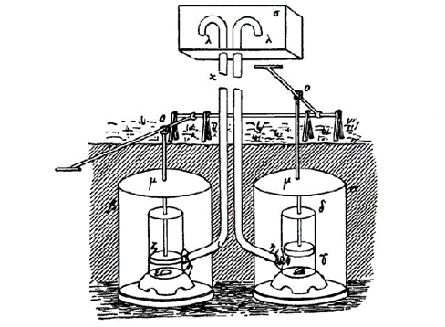
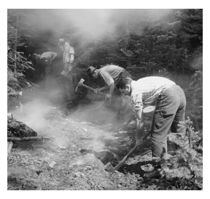
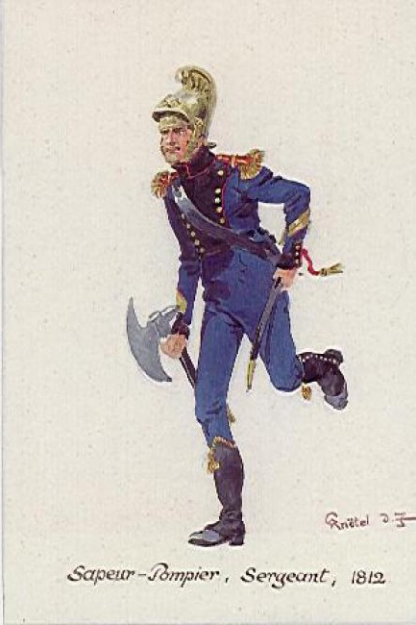
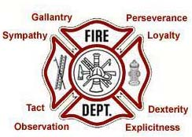
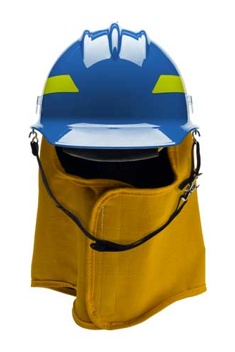
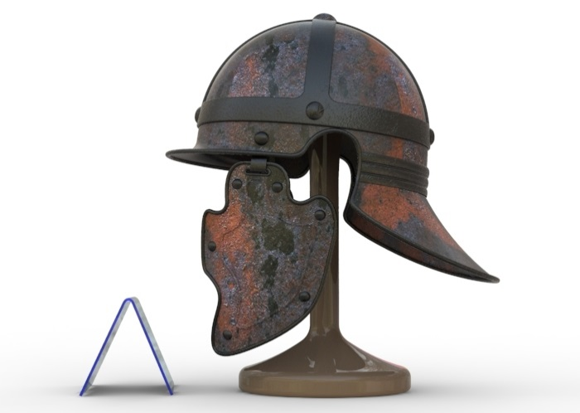
Module 4: Fire Management
FIRE SCIENCES CORE CURRICULUM

Slide 2
FIRE MANAGEMENT
Tradition:
View the History to Understand the Present

Slide 3
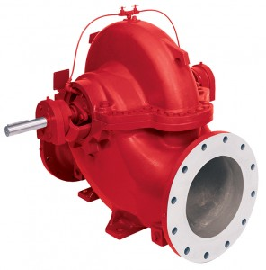
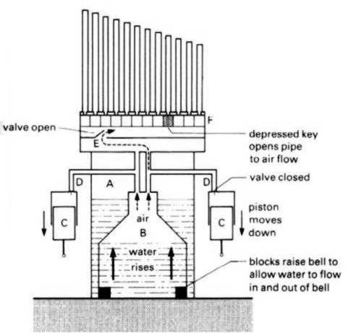
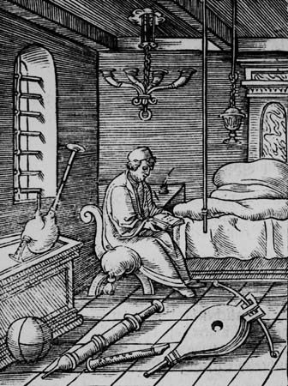
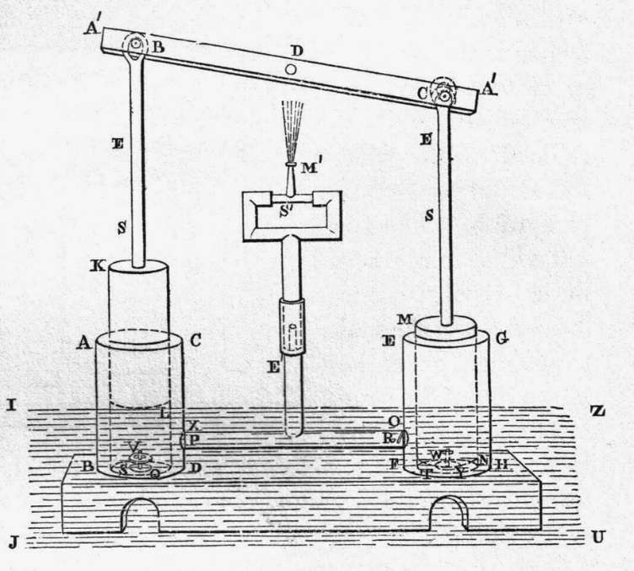
From the beginning, it was about getting wet stuff on the red stuff.
Ctesibius Of Alexandria (200 BC)
http://www.mlahanas.de/Greeks/Ctesibius1.htm

Slide 4
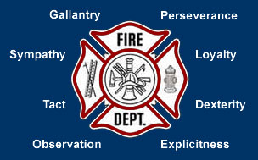
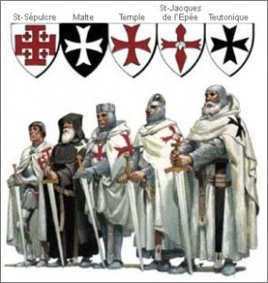
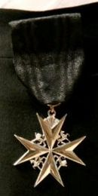
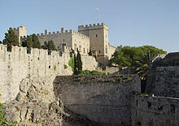

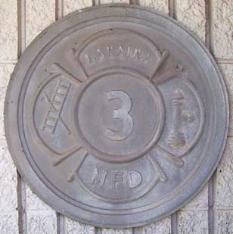
MALTESE CROSS
Notes:
(http://www.fireserviceinfo.com/maltesecross.html)

Slide 5
THE POINTS (FIRE)
Gallantry — The qualities of a hero or heroine; exceptional or heroic courage when facing danger (especially in battle).
Perseverance — Persistent determination.
Loyalty — The quality of being loyal.
Dexterity — Ability to move the hands easily and skillfully.
Explicitness — Fully and clearly expressed; leaving nothing implied.
Observation — The act of observing; taking a patient look.
Tact — Consideration in dealing with others and avoiding giving offence.
Sympathy — An inclination to support or be loyal to or to agree with an opinion.
(http://hpfirefighter.com/2012/08/what-does-the-maltese-cross-stand-for-and-where-did-it-come-from/)

Slide 6
THE POINTS (EMS)
Observant (“that they may note the causes and signs of injury”)
Tactful (“that they may without thoughtless questions learn the symptoms and history of the case, and secure the confidence of the patients and bystanders”)
Resourceful (“that they may use to the best advantage whatever is at hand to prevent further damage, and to assist Nature’s efforts to repair the mischief already done”)
Dexterous (“that they may handle a patient without causing unnecessary pain, and use appliances efficiently and neatly”)
Explicit (“that they may give clear instructions to the patient or the bystanders how best to assist them”)
Discriminating (“that they may decide which of several injuries presses most for treatment by themselves, what can best be left for the patient or bystanders to do, and what should be left for the medics”)
Persevering (“that they may continue their efforts, though not at first successful.”)
Sympathetic (“that they may give real comfort and encouragement to the suffering”)
(St. John Ambulance, The Venerable Order of St. John)

Slide 7
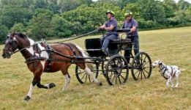
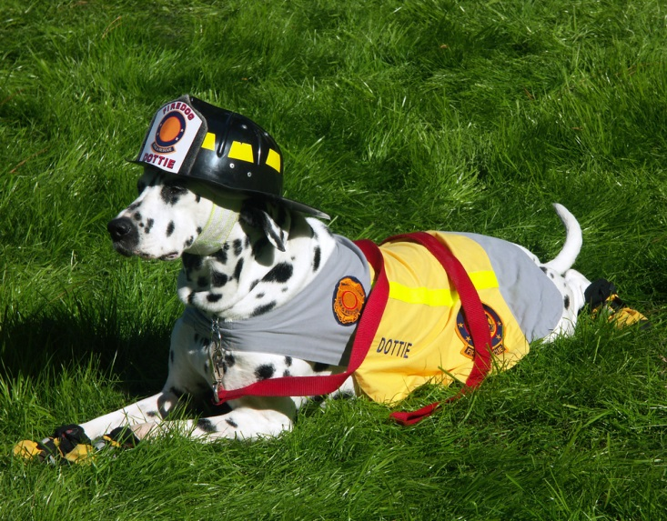
DALMATIAN
When there were horse-drawn fire wagons racing to the scene, the Dalmatians would run out of the firehouse, barking to let bystanders know that they should get out of the way because the firefighters' wagon would soon come roaring by. Then they stood guard near the wagon to ensure that no one stole the firefighter's belongings, equipment, or horses. They were also good ratters, known to catch and kill rats that resided in the old firehouses.

Slide 8
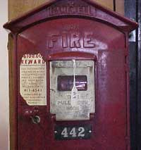
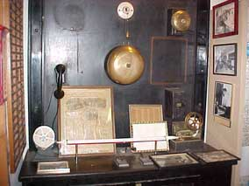
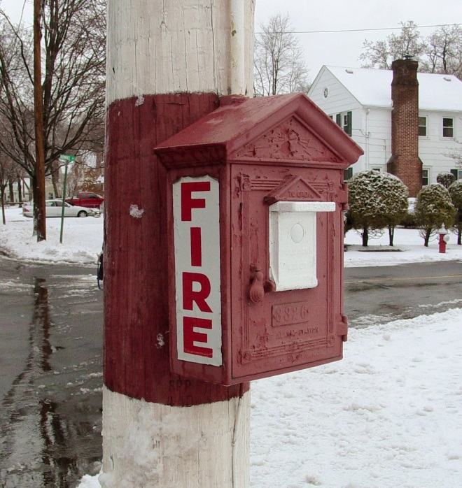
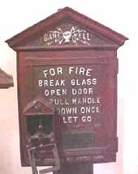
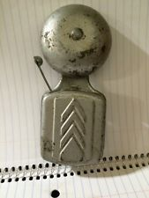
ALARM BOX
When the alarm sounds, the firefighter goes, whenever on shift — day or night. 911 calls have replaced the old telegraph lines that ran for miles.

Slide 9
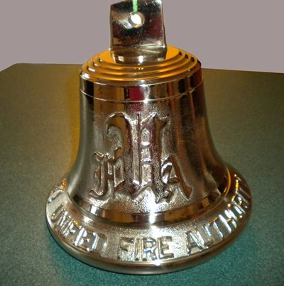
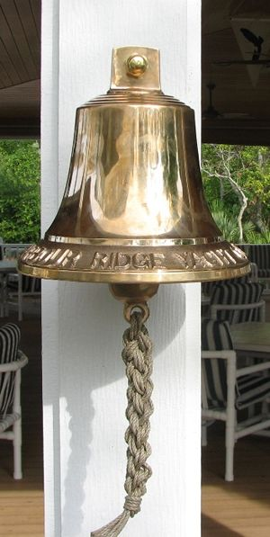
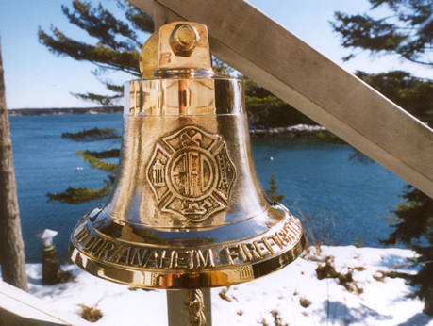
RINGING OF THE BELL
The 5-5-5-5 code has been used in the city's firehouses since 1870; it signals a death, generally of a colleague or the mayor, and tells firefighters to lower the American flag to half-staff.

Slide 10
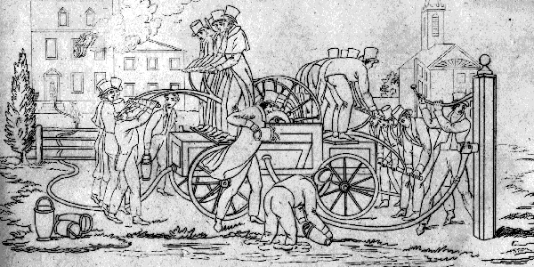
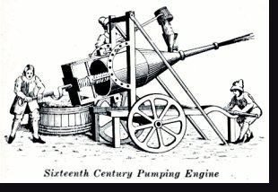
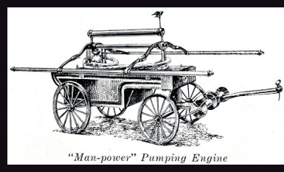
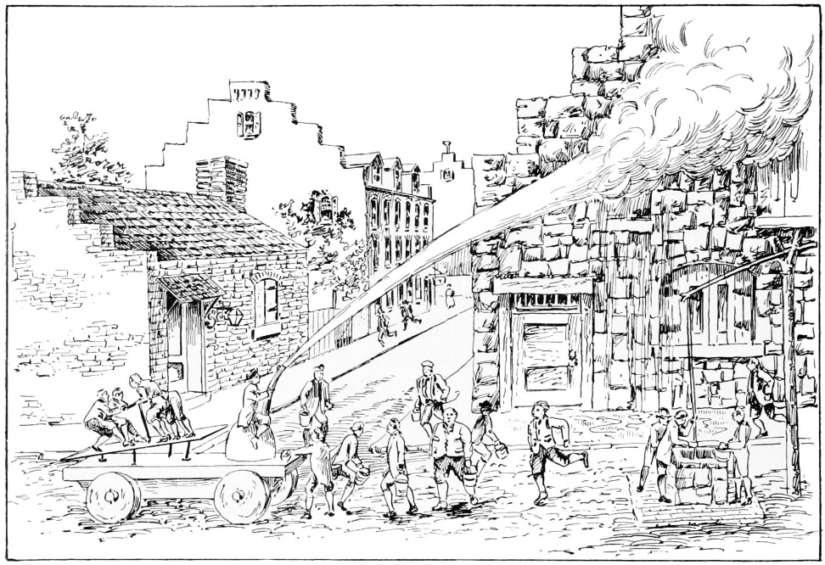
APPARATUS
It was all by hand – hauling buckets and carts.

Slide 11
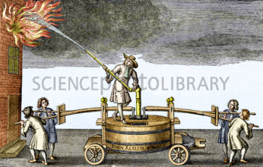
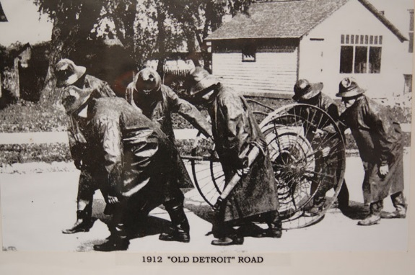
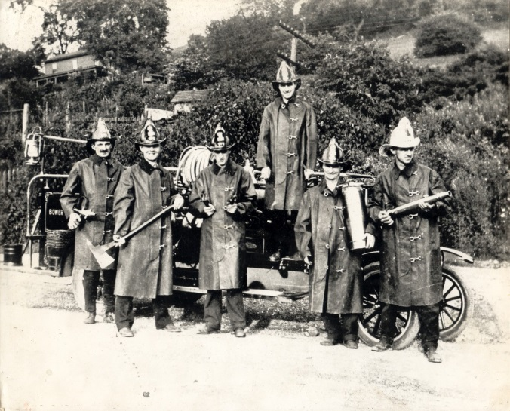
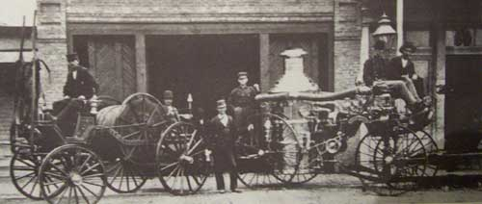
APPARATUS
Ingenious devices – but hand power was getting old and tedious.

Slide 12
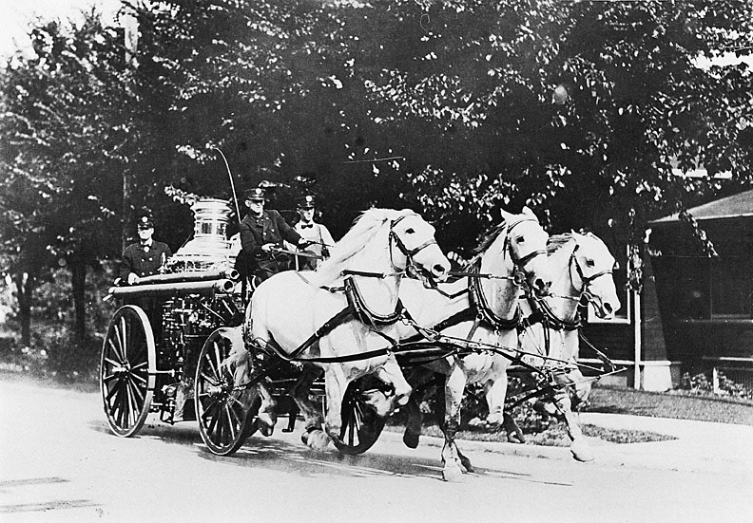
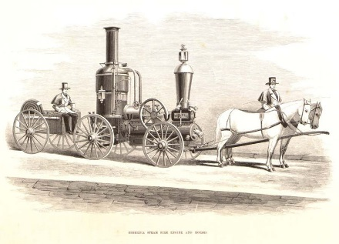
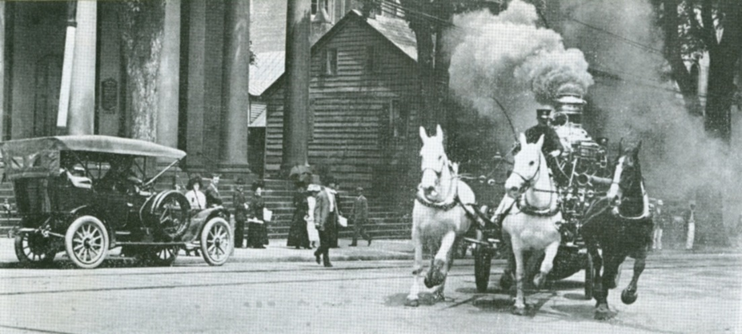
APPARATUS
Horse power made a difference
Top – Oregon History Project (1913); right – Reddit.com (1910); top right - Flickr as Hibernia steam fire engine and horses (1858)

Slide 13
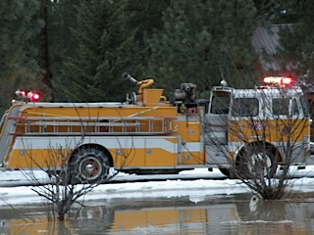
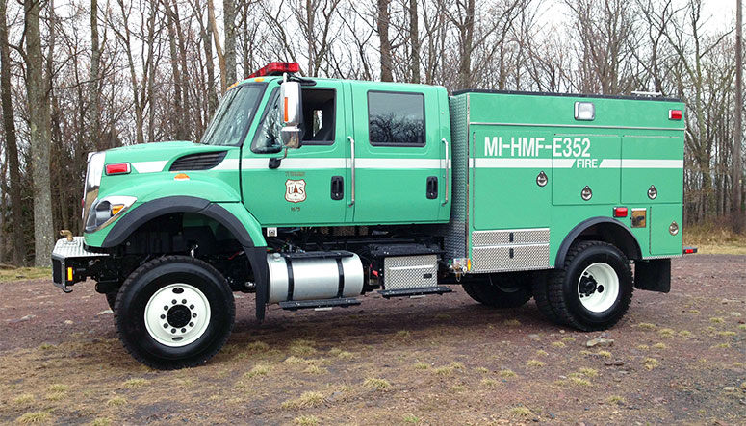
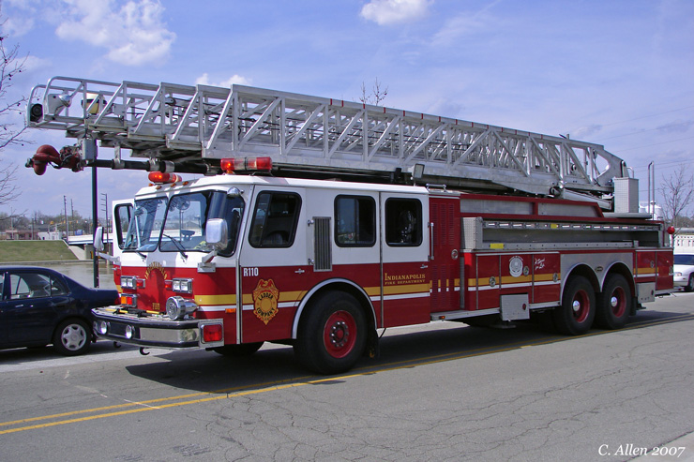
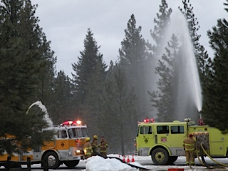
APPARATUS
A lot of horse power
13

Slide 14
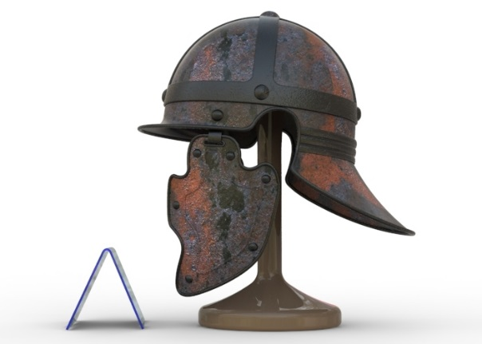
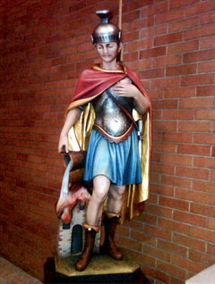
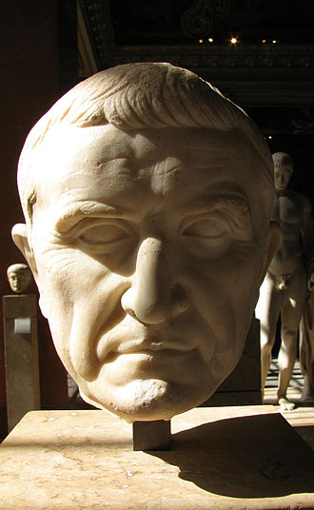
ROMAN FIREFIGHTING
Wooden statue of St. Florian at the St. Joseph’s R.C. Church in Rosebank, Staten Island
The Vigiles or more properly the Vigiles Urbani ("watchmen of the City") or Cohortes Vigilum ("cohorts of the watchmen") were the firefighters and police of Ancient Rome.
Marcus Licinius Crassus – 100 – 50 BC
(Louvre Museum)
Fire Management by Extortion

Slide 15
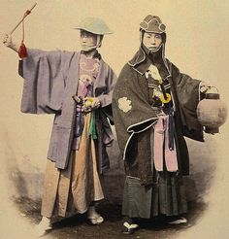
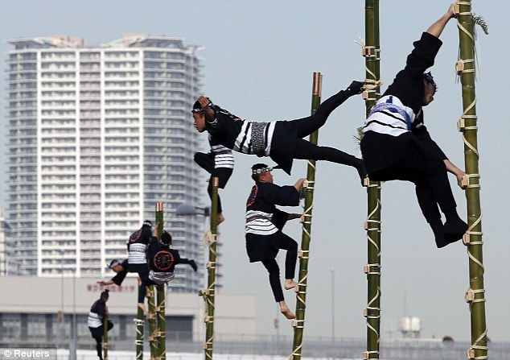
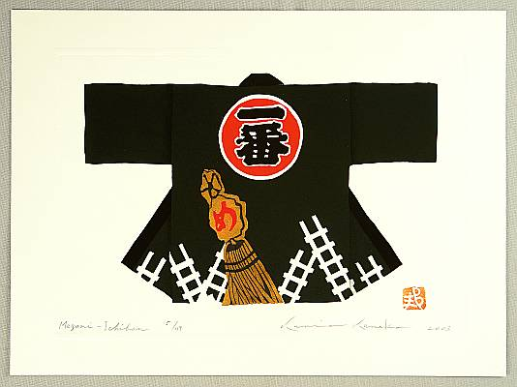
JAPANESE FIREFIGHTING

Slide 16
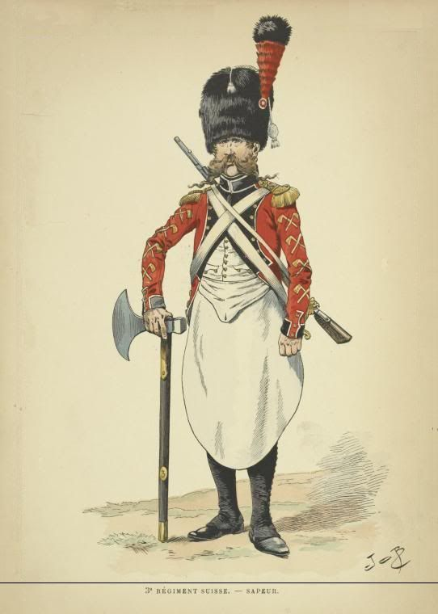
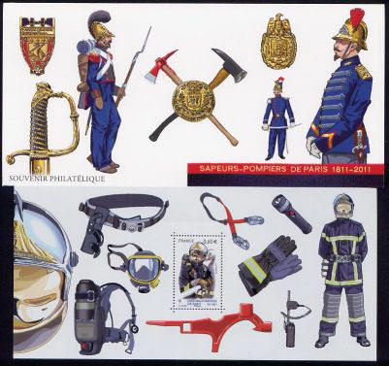
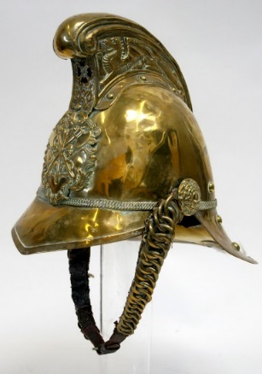
FRENCH FIREFIGHTING
The fire service in France is known as Sapeurs-pompiers, except in Marseille, where naval "sailor-firefighters," marins-pompiers, provide fire and rescue services.

Slide 17
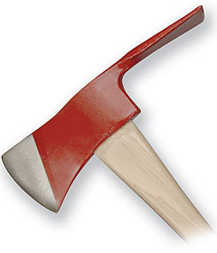




WILDLAND FIREFIGHTING

Slide 18



WILDLAND FIREFIGHTING

Slide 19

DEDICATION

Slide 20

DEDICATION

Slide 21







DEDICATION

